Slide 1
Financial Literacy Curriculum
City of London Academy Trust | Year 9 Assembly

Slide 2
What is FLIC?
The Financial Times news group has set up a charity, Financial Literacy and Inclusion Campaign focused on building up the financial knowledge and skills of everyone in the UK, especially the people that don’t usually come across this information.
Flic have been working with Shoreditch Park to plan lessons that will improve your financial literacy.

Slide 3
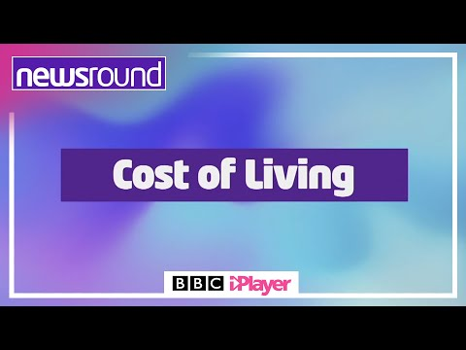
Why is financial literacy important?

Slide 4
Why is financial literacy important?
We have been hearing about the cost of living in the news.
Due to national and international changes, many families are experiencing difficulties with their finances.
We want to make sure that you are equipped with the knowledge and skills that can help you to prepare and protect yourself financially in the future.

Slide 5
Having a respectful learning environment
Money is a very personal topic. People have different values about money and this might be influenced by their circumstances. During your financial literacy lessons, there are some important expectations for keeping our learning environment safe and respectful.
In every lesson;
We will listen to each other respectfully
We will avoid making judgements or assumptions about others
We will comment on what has been said, not the person who has said it
We won’t put anyone on the spot and we have the right to pass
We will not share personal stories or ask personal questions

Slide 6
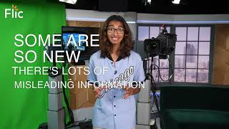
Have you heard of cryptocurrency?
Cryptocurrencies are digital currencies. There are tens of thousands of different cryptocurrencies. Bitcoin is one of the most well-known.

Slide 7

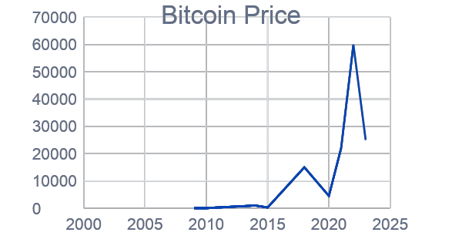
How has the value of bitcoin changed?
Crypto: higher or lower?
Jan 2009
£0
<£0.01
£950
£240
£15,000
May 2010
Dec 2013
Jan 2015
Dec 2017
£4,500
£22,000
£60,000
£25,000
Dec 2019
Dec 2020
Nov 2021
Jan 2022
*Note that the numbers shown have been rounded, so are approximate.
Notes:
The value of Bitcoins has gone up and down over the years since it was created in 2009 and some people don't think it's safe to turn your 'real' money into Bitcoins.
This concern was expressed by the head of The Bank of England, Andrew Bailey, in October 2020.
He said that he was "very nervous" about people using Bitcoin for payments pointing out that investors should realise its price is extremely volatile.
By this, he meant that the value could drop significantly at any moment and investors could lose a lot of money.

Slide 8

What will you be learning?
You will have six lessons on how to make financial decisions.
How to manage financial risk
Session 1 | Session 2 | Session 3 | Session 4 | Session 5 | Session 6
Mobile phone products | Cryptocurrency | Financial exploitation | Online gaming | Online safety | Decision- making Pocket money debate
Don’t forget your calculator!

