Slide 1


How to take care of monthly money
This session is aimed at key stage three (recommended for Year 7)

Slide 2
Unit outline
Session 1 | Session 2 | Session 3 | Session 4 | Session 5 | Session 6
Spending decisions | How to budget | Getting a job | The impact of inflation | The critical consumer | Decision- making task!

Slide 3
Having a respectful learning environment
We will listen to each other respectfully
We will avoid making judgements or assumptions about others
We will comment on what has been said, not the person who has said it
We won’t put anyone on the spot and we have the right to pass
We will not share personal stories or ask personal questions

Slide 4
4
Session: 4
The impact of inflation
Notes:
See Money Matters lesson 5
https://natwest.mymoneysense.com/teachers/resources-8-12s/topic-8-what-affects-my-choices-about-money/lesson-plan/

Slide 5
By the end of the session, I will be able to:
Describe what inflation is and how it is measured
Calculate how budgets are affected by inflation
Explain how inflation can impact people's cost of living

Slide 6
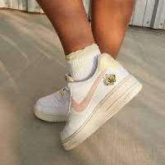
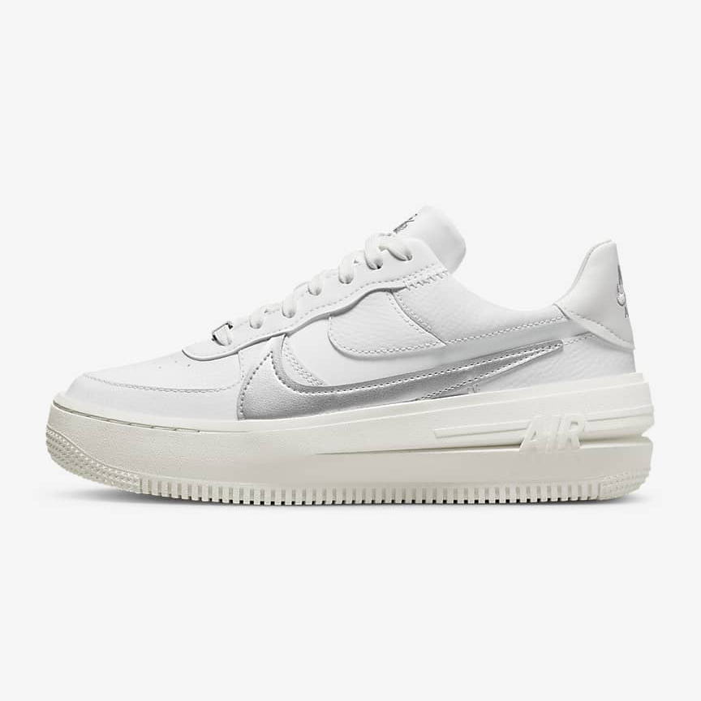
Inflation - Starter
How much do you think the cost of Nikes has changed over time?
What other products have you seen change in price over time?
Can you remember the previous price and today’s price?
Explore your ideas with the person next to you on Post-it notes.
But why?!
2007 | Nike Air Force 1 £76.36
2023 | Nike Air Force 1 £109.95
Optional supporting video resource: https://www.bbc.co.uk/newsround/59320010

Slide 7

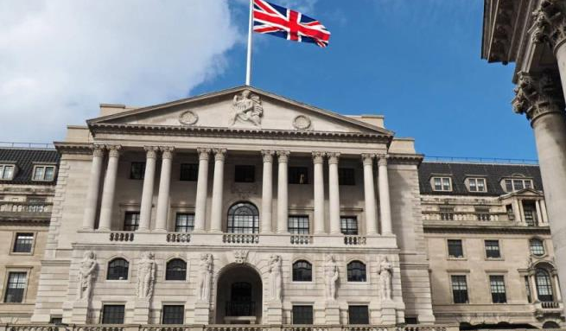
The Bank of England and the target rate of inflation
Welcome to the Bank of England.
The Bank of England is the UK’s central bank and one of its roles is to keep prices stable. It does this by having an inflation target rate of about 2%.
Andrew Bailey
Governor of the Bank of England
See this optional video for a further explanation of the Bank of England

Slide 8
What is inflation?
Copy this definition: What is inflation?
The word we use to describe the rise in general prices
What does this mean?
An annual inflation rate of 2% means that a product that was priced at £1.00 last year will now be priced at £1.02, ie it’s gone up by 2%
When inflation rises, people will be able to buy less of some things with the same amount of money (assuming their income stays the same)
We therefore say that the cost of living increases
Stretch: What is the current inflation rate?
Optional supporting video resource: https://www.youtube.com/watch?v=zPT9RIAcgWY

Slide 9
Are rising prices, aka inflation, always a bad thing?
Generally prices rise year on year a small amount which shows that the level of demand in the economy is growing. It’s when prices rise very fast that people worry as they can’t buy as much with the same amount of money.
Optional supporting video resource: https://www.youtube.com/watch?v=KL7V2A190ws

Slide 10
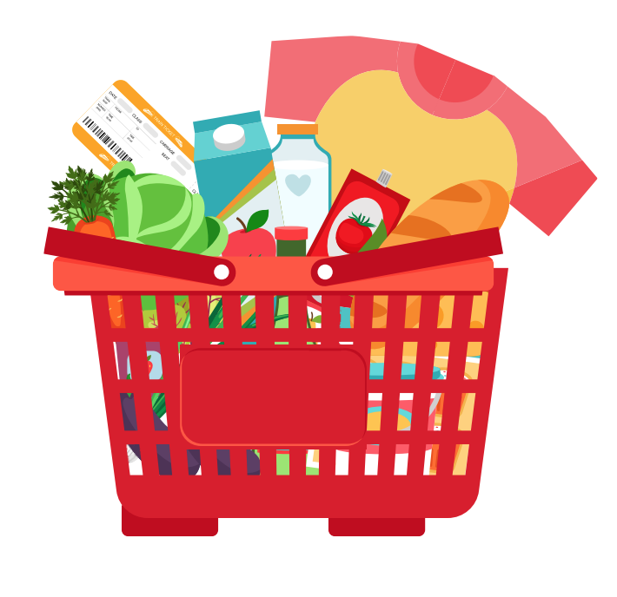
Measuring inflation | Basket of goods
Inflation is measured by tracking how the price of a representative basket of everyday items changes over time.
Consumer inflation is measured by taking a sample ‘shopping basket’ of around 700 goods and services each month in the UK, and monitoring how the total price of the basket changes.
Goods include things like food, clothes and petrol. Services include things like transport, restaurant meals and cinema trips.
This is known as the ‘Consumer Prices Index’ (CPI)
Notes:
.

Slide 11

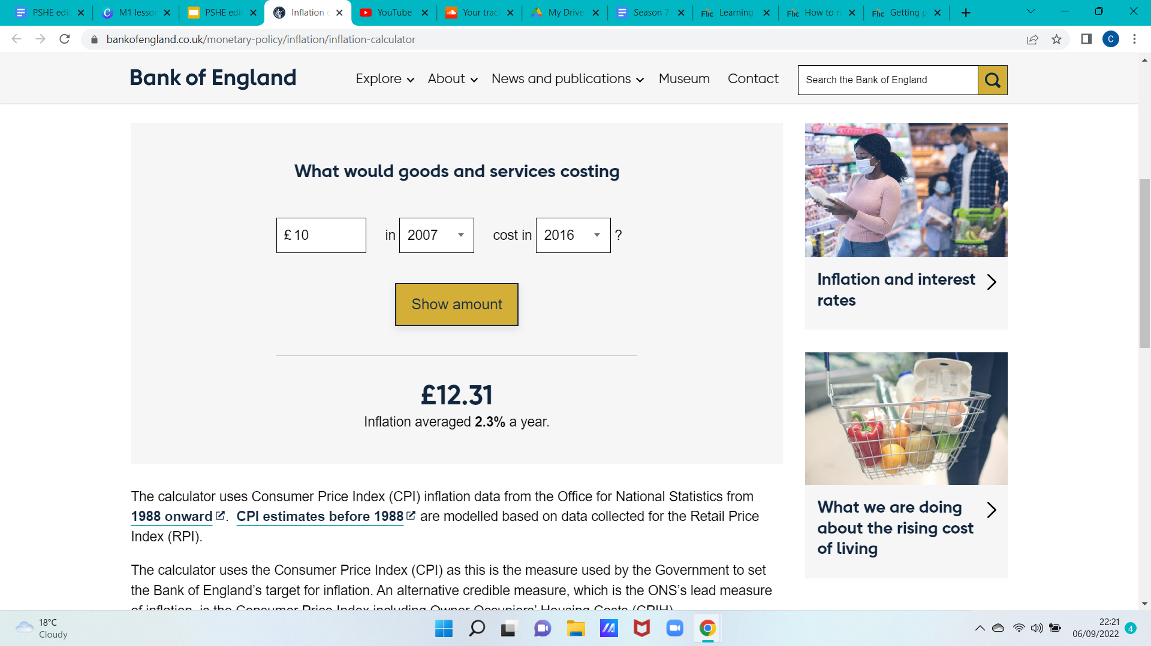
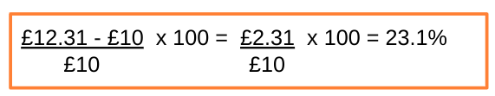
Inflation through the years
Click on the Inflation Calculator. Can you guesstimate how much £10 worth of goods (e.g. can of cola, vegetable oil, petrol) and services (e.g. airline ticket, cinema ticket, restaurant meal) cost when you were born compared to now? Or the cost from when your parent/guardian was born compared to now?
Bank of England inflation calculator
Stretch | Can you work out the percentage increase?
Worked example: If goods and services cost £10 in 2007 AND then cost £12.31 in 2016, we calculate the percentage increase as:
Notes:
Delivery instruction
Encourage less confident students to choose dates to increase engagement and more confident students to work out percentage changes

Slide 12
By the end of the session, I will be able to:
Describe what inflation is and how it is measured
Calculate how budgets are affected by inflation
Consider how inflation can impact people's cost of living

Slide 13
Now over to you to see how food prices have changed over the last few years…

Slide 14
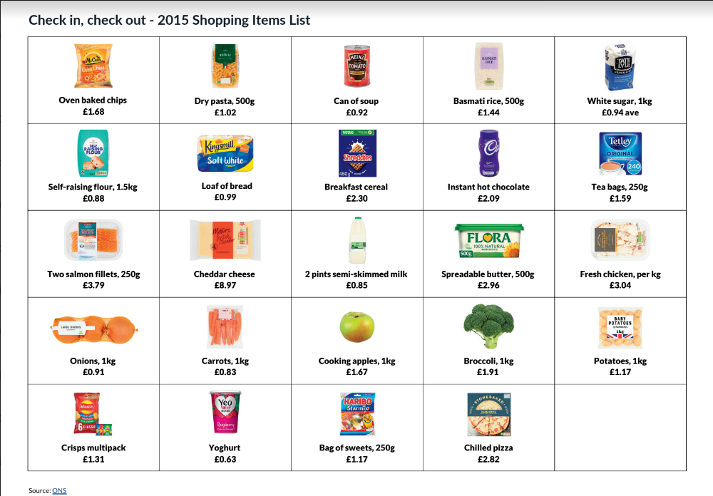
Check in, check out
Part 1 | It’s 2015.
Suppose someone is going food shopping and has a £26.50 budget for their weekly food shop.
Your task is to pick all of the ingredients and items you want to purchase to make meals for a week, sticking to your budget.
Session 4 Resource 1 | Check in, check out

Slide 15
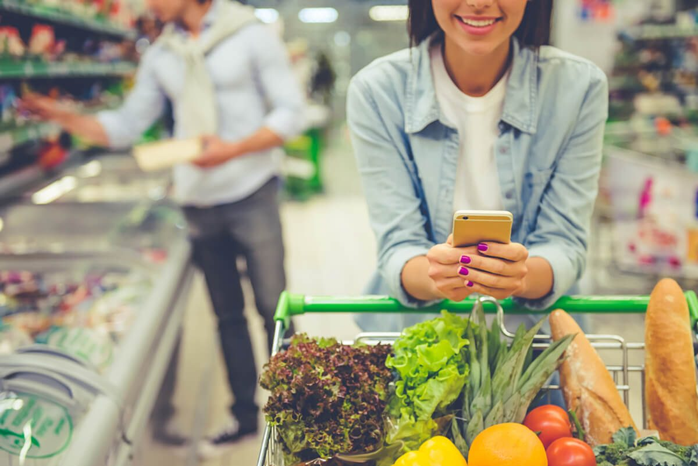
Check in, check out
Part 2 | It’s 2022
We’ve jumped forward a few years and it’s now 2022! Using the 2022 Grocery Items List, calculate the total cost of the same shop at the same supermarket using the updated price list.
Session 4 Resource 1 | Check in, check out
Optional supporting video resource: https://www.youtube.com/watch?v=3dwJYArFsVc
Notes:
Extension teacher prompt questions - Can you differentiate items in your shopping baskets into needs and wants?

Slide 16
Check in, check out
When your shopping lists are completed, answer the following questions:
Is the total cost in 2022 lower or higher than the original £26.50 total?
Which items have increased or decreased in price and why do you think these changes have taken place?
If the cost of products like food have gone up, what does this mean for the money people have left to spend on their needs and wants or that they want to put away to save or invest?
Session 4 Resource 1 | Check in, check out
Notes:
Teacher explanation
Gently explain that while the weekly food shop has increased in price, the money coming in (income) likely hasn’t, so people won’t need to be able to afford all of the same things previously bought.
https://drive.google.com/file/d/1OhLZkWTlXt6yS48hjehRwSBs_7nEP7Yu/view?usp=share_link

Slide 17
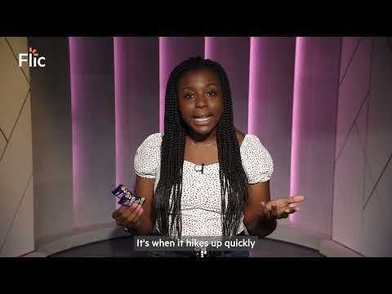
What does inflation mean for people’s money?
Watch the video on the rising cost of Freddos. Use the video to answer the following questions.
Video made in collaboration with Olamide Majekodunmi
Inflation is when the price of things like_________, heating and ____________ go up.
When inflation goes up quickly, what are some ways to help stretch money further?
What’s the impact of rising inflation on savings?
Notes:
Teacher

Slide 18
By the end of the session, I will be able to:
Describe what inflation is and how it is measured
Calculate how budgets are affected by inflation
Consider how inflation can impact people's cost of living

Slide 19
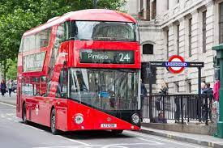
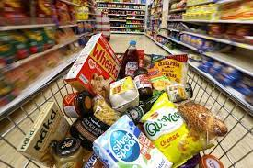
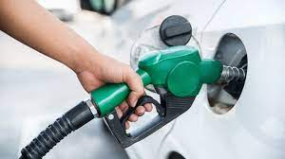
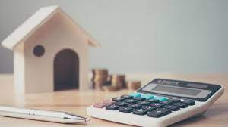
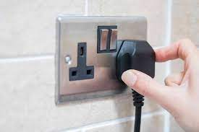
What are some of the main factors that make up the cost of living?
The cost of living is the amount of money a person needs to live
Notes:
Ask students to use the images to help them.

Slide 20
What are some of the main factors that make up the cost of living?
The cost of living is the amount of money a person needs to live
Transport
Food
Fuel
Rent/ Mortgage repayments
Electricity
Notes:
Teacher explanation
These are some of the core factors that contribute to the cost of living. You may ask students to consider other factors. These may include: taxes, healthcare, entertainment, water and gas.

Slide 21
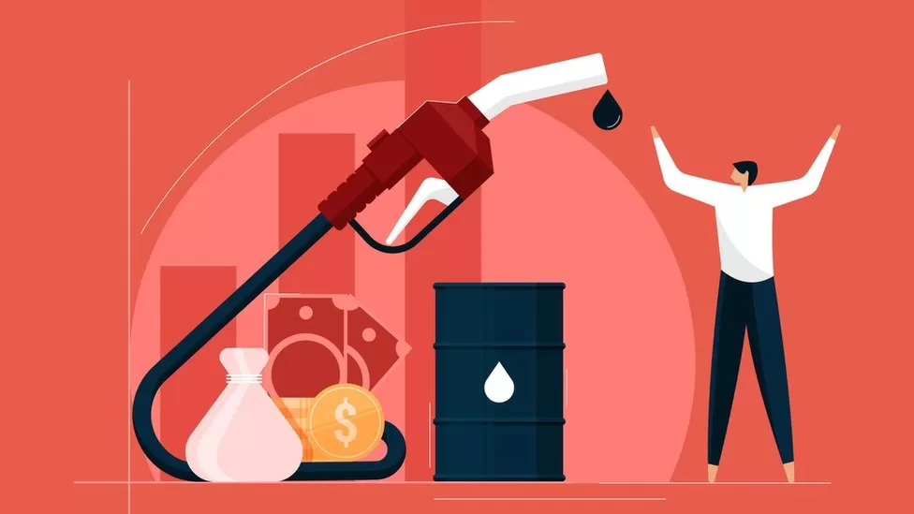
Inflation and the cost of living
Watch the video (5:11) and discuss the following questions
Discussion
1. What kind of decisions are people needing to make?
2. What kind of things does Charlie suggest people can do to help with the cost of living?
Video: https://www.bbc.co.uk/newsround/62038311

Slide 22
Inflation and well-being
For many families rising inflation leading to a rising cost of living has been stressful to manage.
Remember that inflation changes over time and this period will not last forever.
As you have learnt, there are things that people can do to adjust their budgets including reconsidering what things are needs and wants.
There are many sources of advisory services and help for families who are experiencing financial difficulties.
Optional supporting video resource: https://www.youtube.com/watch?v=669PyOJJohY

Slide 23



Services available for people who have concerns about their personal finances
Citizens Advice – Debt and Money – This resource contains links to advice on a number of topics, including financial difficulties, cost of living and communicating with creditors.
National Debtline – Debt and Money – a debt advice charity run by the Money Advice Trust, offering a free and confidential debt advice service.
Childline Helpline
0800 1111
At school, you can speak with an adult you trust.
This could be your form tutor, head of year or the school’s safeguarding officer.

Slide 24
Any questions?
?

Slide 25
By the end of the session, I will be able to:
Describe what inflation is and how it is measured
Explain how inflation is measured
Consider how inflation can impact people's cost of living

Slide 26
Links to learn more!
Articles to extend learning
Please visit the FLIC learning hub - https://ftflic.com/learning-hub/ for further resources
How is inflation affecting your household costs? (Census, March 2022)
‘What is the UK's inflation rate and why is the cost of living going up? (BBC, Feb 2022)
How does inflation affect me? (Teen Learner, Sept 2021)
Will inflation in the UK keep rising? (Bank of England, May 2022)
Notes:
A number of the video links have been added to the relevant slides
https://www.bbc.co.uk/news/uk-61744144
https://www.youtube.com/watch?v=KL7V2A190ws
https://www.youtube.com/watch?v=669PyOJJohY
https://www.bbc.co.uk/newsround/63664110
https://www.ft.com/cost-of-living-crisis

Slide 27
OPTIONAL MULTIPLE CHOICE QUIZ
Can be used in form time to consolidate learning.

Slide 28
Inflation | Multiple choice
Inflation is…
A | B | C
the increase in prices of goods and services over time | the decrease in prices of goods and services over time | when prices of goods and services remain the same over time

Slide 29
Inflation | Multiple choice
Inflation is…
A | B | C
the average rise in prices of items over time | the decrease in prices of items over time | when prices of items remain the same over time

Slide 30
Inflation | Multiple choice
2. When inflation goes up…
A | B | C
Spending increases as people have more money to spend | Spending decreases as the cost of living goes up so people have less money to spend | Nothing changes because people's spending is not affected

Slide 31
Inflation | Multiple choice
2. When inflation goes up…
A | B | C
Spending increases as people have more money to spend | Spending decreases as the cost of living goes up so people have less money to spend | Nothing changes because people's spending is not affected

Slide 32
Inflation | Multiple choice
3. The Bank of England wants to keep the target inflation rate at around
A | B | C
0% | 2% | 7%

Slide 33
Inflation | Multiple choice
3. The Bank of England wants to keep the target inflation rate at around
A | B | C
0% | 2% | 7%

Slide 34
Inflation | Multiple choice
4. Which of these items was removed from 2022’s basket of goods and services?
A | B | C
Pizza | Anti-bacterial wipes | Men’s suits

Slide 35
Inflation | Multiple choice
4. Which of these items was removed from 2022’s basket of goods and services?
A | B | C
Pizza | Anti-bacterial wipes | Men’s suits

Slide 36
Inflation | Multiple choice
5. When shrinkflation happens, a product's price in shops (retail price) stays the same, but what happens to its size?
A | B | C
Decreases | Increases | Stays the same

Slide 37
Inflation | Multiple choice
5. When shrinkflation happens, a product's price in shops (retail price) stays the same, but what happens to its size?
A | B | C
Decreases | Increases | Stays the same

Slide 38
Inflation | Multiple choice
6. Inflation is measured by taking a sample ‘shopping basket’ of around how many goods and services across the UK?
A | B | C
70 | 700 | 7000

Slide 39
Inflation | Multiple choice
6. Inflation is measured by taking a sample ‘shopping basket’ of around how many goods and services across the UK?
A | B | C
70 | 700 | 7000

Slide 40
Inflation | Multiple choice
7. The ……………………….. is measured by taking a sample ‘shopping based’ of around how many goods and services across the UK?
A | B | C
Bank of England | Producer price index | Consumer price index

Slide 41
Inflation | Multiple choice
7. The ……………………….. is measured by taking a sample ‘shopping based’ of around how many goods and services across the UK?
A | B | C
Bank of England | Producer price index | Consumer price index

Slide 42
Inflation | Multiple choice
8. When inflation goes up over the long run, what happens to the value of salary money earned from a job (assuming it stays the same)?
A | B | C
It goes down | It goes up | It is not impacted

Slide 43
Inflation | Multiple choice
8. When inflation goes up over the long run, what happens to the value of salary money earned from a job (assuming it stays the same)?
A | B | C
It goes down | It goes up | It is not impacted

