Slide 1
Financial Literacy Curriculum
Year 7 Assembly

Slide 2
What is FLIC?
The Financial Times news group has set up a charity, Financial Literacy and Inclusion Campaign focused on building up the financial knowledge and skills of everyone in the UK, especially the people that don’t usually come across this information.
Flic have been working with Shoreditch Park to plan lessons that will improve your financial literacy.

Slide 3
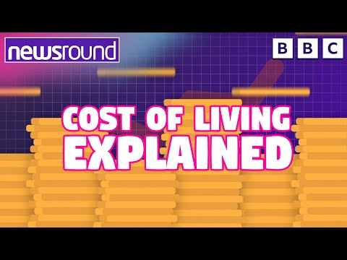
Why is financial literacy important?

Slide 4
Why is financial literacy important?
We have been hearing about the cost of living in the news.
Due to national and international changes, many families are experiencing difficulties with their finances.
We want to make sure that you are equipped with the knowledge and skills that can help you to prepare and protect yourself financially in the future.

Slide 5
Having a respectful learning environment
Money is a very personal topic. People have different values about money and this might be influenced by their circumstances. During your financial literacy lessons, there are some important expectations for keeping our learning environment safe and respectful.
In every lesson;
We will listen to each other respectfully
We will avoid making judgements or assumptions about others
We will comment on what has been said, not the person who has said it
We won’t put anyone on the spot and we have the right to pass
We will not share personal stories or ask personal questions

Slide 6

Every child should have a laptop. Do you agree?
You have two minutes to discuss your opinion with the person next to you.
You must give a reason to support your argument. Even better if you have examples.

Slide 7
Every child should have a laptop. Do you agree?
Some people would say that a laptop is a luxury or a want and you can live without one.
Other people would say that a laptop is a need, especially after 2020 where we had to adapt to the pandemic and learn and work from home.
How does this link to money? Knowing the difference between a need and a want is one of the first steps to thinking about how you can spend your money wisely.
This will be the topic of your first financial literacy lessons.

Slide 8
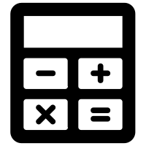
What will you be learning?
You will have six lessons on how to make financial decisions
How to look after your monthly money
Session 1 | Session 2 | Session 3 | Session 4 | Session 5 | Session 6
Spending decisions | How to budget | Getting a job | The impact of inflation | Being a critical consumer | Decision making task- Budgeting for a holiday
Don’t forget your calculator!

