Slide 1
How to prepare for your financial future
This session is aimed at key stage four and five (recommended for Year 12 and above)

Slide 2
Unit outline
Session 1 | Session 2 | Session 3 | Session 4 | Session 5 | Session 6
How the economy works | Mortgages | Credit cards | Pensions | ISAs | Decision- making - Financial decisions
Notes:
Josh oliver

Slide 3
Having a respectful learning environment
We will listen to each other respectfully
We will avoid making judgements or assumptions about others
We will comment on what has been said, not the person who has said it
We won’t put anyone on the spot and we have the right to pass
We will not share personal stories or ask personal questions
If there is a question that you do not wish to ask aloud, you can write it on a Post-it Note which will be collected throughout the session and answered at the end

Slide 4
4
Session 2:
Mortgages

Slide 5
5
By the end of the session, I will be able to:
Describe what a mortgage is
Analyse the mortgage application process
Suggest positive financial behaviours to prepare for the mortgage application process

Slide 6
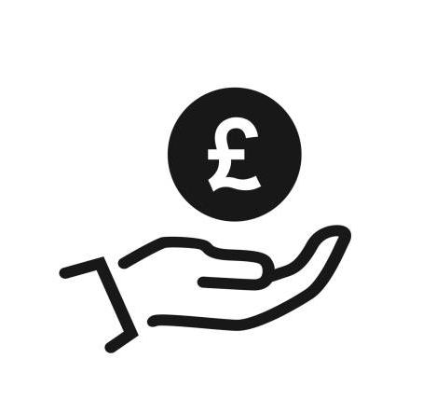


Starter | UK housing market
Average yearly salary?
65%
£33,500
£261,000
% of homeowners
in the UK?
Average house
price?
Sources:
Median pay for full time employees (ONS). April 2022 - Actual figure of £640 per week. Calculations and roundings have been made to accommodate the activity.
Average house prices in the UK | FT UK house prices
Notes:
Teacher Explanation
Delivery Instructions
Begin by revealing the current average salary and average house price in the UK after students have had a short amount of time to think about it.The calculation required is on the next slide. Frame the necessity of a mortgage in this context, making sure to emphasize that without a mortgage, homeownership would be out of reach for most individuals.
Prompt Questions
What assumptions are we making in this calculation about other expenses and savings?
Does everyone's financial situation look the same? How might different financial circumstances change the amount someone could save or the price of the house they might buy?
What are some other reasons, besides the cost of a house, that someone might choose to get a mortgage?

Slide 7
Starter | UK housing market
Activity
How many years would it take for someone to buy a house outright (without a mortgage) if they saved 20% of their salary each year?
Based on the figures from the question above, discuss with a partner why someone might need a mortgage to buy a house.
?

Slide 8
Starter | UK housing market
Yearly saving: 20% of £33,500 = £6,700
Stretch
What factors might increase the amount of time it would take to buy a house outright?
What factors might decrease the amount of time it would take to buy a house outright?
Divide the average house price by the yearly saving to calculated how long it would take to save that amount
261,000 ➗6,700 = 38.955….
Therefore, it’d take over 39 years to save enough money to pay for the average house outright
Notes:
Teacher Explanation
Delivery Instructions
Prompt Questions

Slide 9
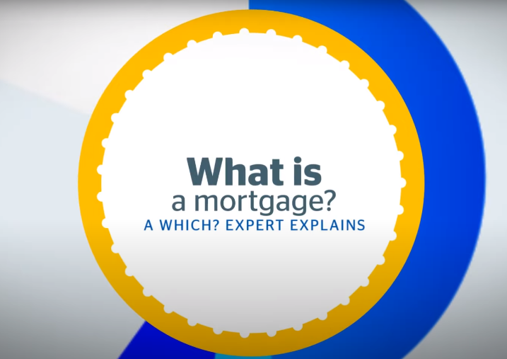

What is a mortgage?
What questions do you have about mortgages? Now watch the video.
Questions
In what circumstances might someone opt for an interest only mortgage over a repayment mortgage?
What’s the difference between a fixed rate and variable rate mortgage?
Things to consider
Mortgages vs other loans
Mortgage amount vs house price
Types of mortgage
Video: https://www.youtube.com/watch?v=g-uAurjxCiU
Notes:
Teacher Explanation
Emphasise that the goal isn't to predict the content perfectly, but to prime their thinking about mortgages. After watching the video, facilitate a brief discussion comparing the expected vs actual content of the video.
Delivery Instructions
Prior to playing the video (which is on the next slide), have students take a moment to jot down bullet points on what they expect the video will cover about mortgages. After the video, students should review their bullet points and note any discrepancies or new information learned.
Prompt Questions

Slide 10
Deciding to get a mortgage?
At what stage of life might a person consider getting a mortgage?
Why might a person feel that renting is a better option?
What financial factors should a person consider when getting a mortgage?
?

Slide 11
11
By the end of the session, I will be able to:
Describe what a mortgage is
Analyse the mortgage application process
Suggest positive financial behaviours to prepare for the mortgage application process

Slide 12
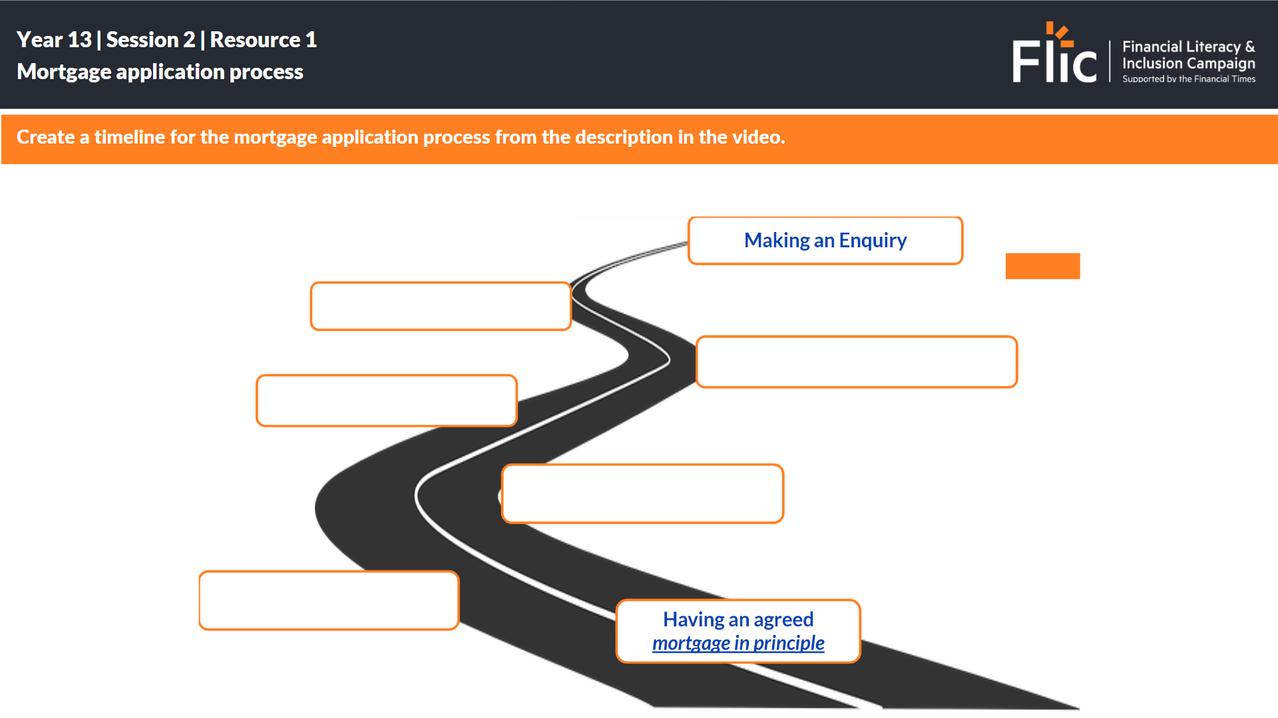
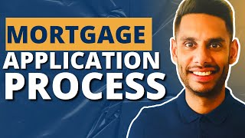
Mortgage application process
As you watch the video, write down the order of the different steps detailed below, in the correct order, for making a mortgage application
Property valuation to make sure that the property is suitable. For example, if the lender needs to repossess the property they need to get the money back on time.
Make an enquiry to a mortgage broker or bank
Mortgage broker or bank takes all your details down - dependants, credit file, proof of income and bank statements will be reviewed.
Submit income documents like payslips, P60s, tax statements.
Get a mortgage offer. Means finance documents from the bank have been officially approved.
https://www.youtube.com/watch?v=oGc7wAC6xb8

Slide 13
Mortgage application process
Stage 1: Make an enquiry to a mortgage broker or bank.
Mortgage broker or bank takes all your details - dependants, credit file, proof of income and bank statements will be reviewed.
Stage 2: Submit income documents like payslips, P60s, tax statements.
Stage 3: Property valuation to make sure that the property is suitable. For example, if the lender needs to repossess the property they need to get the money back on time.
Stage 4: Get a mortgage offer. Means finance documents from the bank have been officially approved.
Notes:
As you watch the video, write down the order of the different steps to making a mortgage application, using below.
Provide mortgage quotes, including term, fees, mortgage rates

Slide 14

Class discussion
Shivaughn is about to start the mortgage application process.
Shivaughn is self-employed and has had a good year in profits after a period of variable income.
Shivaughn has been saving for some time and has accumulated £22,000 for their deposit.
Although Shivaughn has been saving, they have also been using credit cards and sometimes uses their overdraft.
Which parts of the process might be Shivaughn be concerned about?
What can Shivaughn do to be better prepared?

Slide 15
Class discussion
Shivaughn is about to start the mortgage application process.
Shivaughn is self-employed and has had a good year in profits after a period of variable income.
Shivaughn has been saving for some time and has accumulated £22,000 for their deposit.
Although Shivaughn has been saving, they have also been using credit cards and sometimes uses their overdraft.
Which parts of the process might be Shivaughn be concerned about?
What can Shivaughn do to be better prepared?

Slide 16

Maths moment
Shivaughn wants to take out a mortgage for a property valued at £200,000.
How much is the deposit?
What amount is being borrowed for the mortgage?
What salary would they need to be earning?
Property value
£200,000 one bedroom flat
10% deposit needed
£20,000 deposit
Value of mortgage offered
£200,000 - £20,000
£180,000 mortgage
Salary needed
£180,000 4.5
£40,000 salary

Slide 17
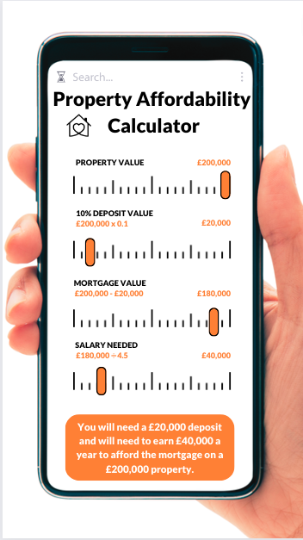
Reflection
Explain three key terms you have learnt about the mortgage application process?
Give two words that describe how you feel about the mortgage application process.
What is your one stand out ‘did you know’ that you would share with other young people who haven’t learnt about mortgages?

Slide 18
14
By the end of the session, I will be able to:
Describe what a mortgage is
Analyse the mortgage application process
Suggest positive financial behaviours to prepare for the mortgage application process

Slide 19

Preparing for your financial future
Lucy is 18 and has aspirations to own her own home.
Lucy knows that the average age of a first time buyer is 33 years old.
Lucy feels that this is a realistic goal and would like to be financially ‘ready’ when she decides to start the mortgage application process.
What can Lucy do to be financially prepared for the mortgage application process?

Slide 20
Preparing for your financial future
Here are some things Lucy might want to consider:
Explore personal reasons why home ownership is the preferred option, or not
Research cost of living in different locations
Consider how career options and earnings match other future goals
Assess personal budgets - what proportion is being spent on needs and wants and how much is being saved? How will this change with a mortgage?
Build financial habits like regular saving and managing bill payments

Slide 21
14
By the end of the session, I will be able to:
Describe what a mortgage is
Analyse the mortgage application process
Suggest positive financial behaviours to prepare for the mortgage application process

Slide 22
Any questions?
?

Slide 23



Organisations providing information on mortgages
Martin Lewis’ MoneySavingExpert site has a section devoted to mortgages.
Money Helper’s ‘Homes’ sections provides advice on a range of areas around buying a home.
Which offers advice on how mortgages work, provide tools to compare products, and plan mortgage solutions to fit your needs.
A lot of it looks directly at mortgage products, but there is a great deal of information about mortgages more broadly.
At school, you can speak with an adult you trust.
This could be your form tutor, head of year or the school’s safeguarding officer.

