Slide 1
How to prepare for your financial future
This session is aimed at key stage four and five (recommended for Year 12 and above)

Slide 2
Having a respectful learning environment
We will listen to each other respectfully
We will avoid making judgements or assumptions about others
We will comment on what has been said, not the person who has said it
We won’t put anyone on the spot and we have the right to pass
We will not share personal stories or ask personal questions
If there is a question that you do not wish to ask aloud, you can write it on a Post-it Note which will be collected throughout the session and answered at the end

Slide 3
Unit outline
Session 1 | Session 2 | Session 3 | Session 4 | Session 5 | Session 6
The economy | Mortgages | Credit cards | Pensions | ISAs | Decision- making

Slide 4
4
Session 1:
The economy

Slide 5
By the end of the session, I will be able to:
Describe what is meant by ‘the economy’
State the government’s main economic objectives
Explain how decisions about the economy affect people and their lives

Slide 6
The economy
Karim says: “The economy hasn’t been doing too well lately. I hope it will pick up soon as business has been slow.”
What do you think he means by ‘the economy’?
What do you think he means by this statement?

Slide 7
What is the economy?
Economists say economics is the study of scarcity. That’s because resources, such as workers, land and raw materials, are limited – while demand for them is unlimited. Basically, we always want more.

Slide 8
The economy
For example, in any healthcare system there are limits on the supply of doctors, nurses and hospital beds. This causes waiting lists for certain operations.
Video: https://vimeopro.com/bankofengland/econome/video/241881362

Slide 9
What is the economy?
Economists say economics is the study of scarcity. That’s because resources, such as workers, land and raw materials, are limited – while demand for them is unlimited. Basically, we always want more.
So the textbook answer is an economy is a system for distributing scarce resources. The economy may also be described as a social science that studies the production, distribution, and consumption of goods and services.
In some countries, the government chooses what to produce, how much and for whom. In others, it’s determined by what people want to buy, and how much businesses can provide – supply and demand.

Slide 10
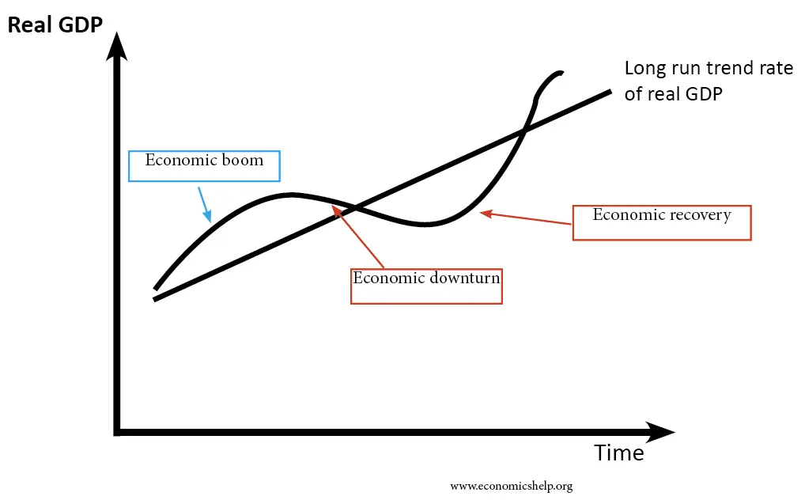
Boom and bust cycle
All economies have a long term trend rate of growth.
The UK’s trend rate of growth was about 2% per year, but it’s been fairly flat since the financial crisis (2008-2009). Around that, there will be booms and busts:
Economic growth
Booms are when the economy is in a period of rapid growth. Employment is usually high and there is positive business and consumer confidence
Boom
Recovery
Bust
Busts are when economic growth declines and there is usually low employment and low business/consumer confidence
When Karim says the economy “isn’t doing too well lately” it’s likely that the economy is in an economic bust (downturn) - jobs rates are low, consumer and business confidence is low and there is not a lot of government money to spend on things like education or healthcare.
Read more about the UK’s slow growth rate here: https://www.ft.com/content/dd195cda-ca12-48a6-9e8b-65a36e4e7c14

Slide 11
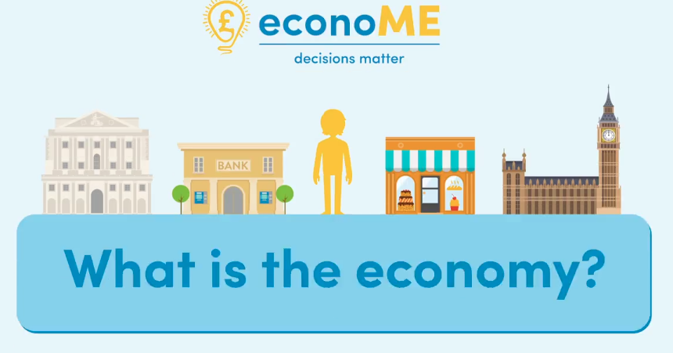
The economy
Watch the clip, until 2:38, and write down 3-5 key points on how the economy is linked to consumers and businesses
https://vimeopro.com/bankofengland/econome/video/241881362
Video: https://vimeopro.com/bankofengland/econome/video/241881362

Slide 12
Key points | Consumers and businesses
Consumers
Businesses
Consumers are a part of the economy as they decide what to buy and how much to spend
Businesses make money by selling goods (tangible things like food or clothes) and services (experiences for consumers like legal advice or going to the cinema)
Consumers also receive money. They may be employed by organisations and receive wages, or be self-employed or be retired and unable to work and receive benefits or pensions.
If businesses are successful they grow, and are able to employ more staff or pay higher wages
High street banks look after people’s savings, lend money and help people pay for things.

Slide 13
By the end of the session, I will be able to:
Describe what is meant by ‘the economy’
State the government’s main economic objectives
Explain how interest rate changes affect people and their lives

Slide 14
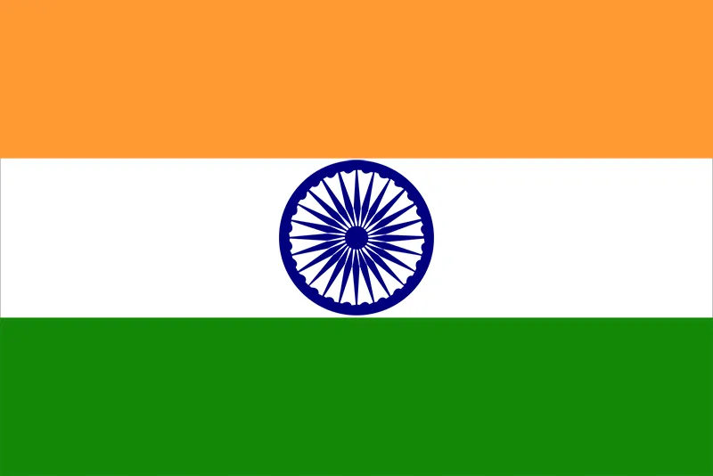
Global economies
Economic growth is measured by gross domestic product (GDP).
GDP is the total amount of income generated from goods and services sold.
Can you rank these countries in order of highest to lowest GDP?
Stretch - guesstimate the GDP in trillions of dollars for each country
2022 data
Italy
United States
China
Brazil
Japan
United Kingdom
India
Germany
France
Source: World Bank reference https://globalpeoservices.com/top-15-countries-by-gdp-in-2022/
Notes:
Prompt questions
Why have you chose your top 3?
Why have you chosen your bottom 3?
What makes some countries richer than clothes?

Slide 15
Global economies | ANSWERS
Can you rank these countries in order of highest to lowest GDP?
Stretch - guesstimate the GDP in trillions of dollars for each country
2022 data
1. United States ($20.89tn)
4. Germany ($3.85tn)
7. India ($3.85tn)
2. China ($14.72 tn)
5. UK ($2.67 tn)
8. Italy ($2.07 tn)
3. Japan ($4.97 tn)
6. France ($2.78 tn)
9. Brazil ($1.44tn)
Source: World Bank reference https://globalpeoservices.com/top-15-countries-by-gdp-in-2022/

Slide 16
What makes some economies more successful than others?
Consider:
Internal factors
what’s going on in the country
External factors
what’s happening outside of the country
Employment levels
What factors affect an economy?

Slide 17
What makes some countries more successful than others?
Consider:
Internal factors
what’s going on in the country
External factors
what’s happening outside of the country
Employment levels
Economic health of trading partners
Innovation and entrepreneurship
What factors affect an economy?
Good governance/
Social mobility
Taxation and public services, like health
Natural resources e.g. copper, fertile land

Slide 18
Economic objectives
Most countries have 3-4 main aims for their economy:
1. High but sustainable economic growth
Businesses thriving and consumer confidence high
2. Low and stable inflation of 2%
Inflation is the general increase in price levels
3. Low unemployment
Lots of people in work
4. Balance in international trade
So there’s a balance between money being spent on goods and services coming in [imports] and going out [exports]. This is known as the balance of payments.

Slide 19
Economic objectives
Most countries have 3-4 main aims for their economy:
1. High but sustainable economic growth
2. Low and stable inflation of 2%
3. Low unemployment
4. Balance in international trade
Write a paragraph describing what economic objectives you think are most important for a country’s success and why.
Word Bank
security stability cost of living
environment wellbeing savings
corruption inequality levels opportunities

Slide 20
By the end of the session, I will be able to:
Describe what is meant by ‘the economy’
State the government’s main economic objectives
Explain how interest rate changes affect people and their lives

Slide 21
The economy and the Bank of England
As you watch the clip, from 2:38, make a note of at least 3 key points about the role of the Bank of England.
Video: https://vimeopro.com/bankofengland/econome/video/241881362

Slide 22
The role of the Bank of England is to…
Look after the UK economy and financial system
Ensure people have access to bank notes
Keep the high street banks safe and sound
Set the bank rate, which is the key interest rate in the UK and affects the economy
Keep inflation (the general rise in prices) at a target rate of 2%
It is independent of the government. Why do you think this may be?
Notes:
Teacher explanation
The Bank of England is independent so that it can make decisions on its own without being swayed by politics. This is because, for example, the government might be incentivised to spend before an election, which would raise inflation.

Slide 23
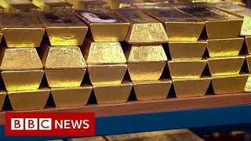
The gold
The Bank of England houses > 400,000 gold bars worth over £100bn.
Take a look inside…
https://www.youtube.com/watch?v=yLLcGmvW8WA

Slide 24
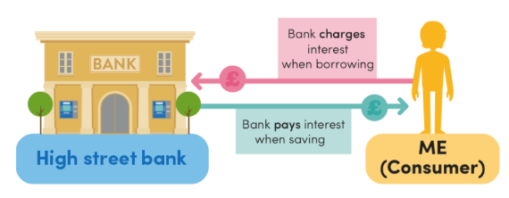
Inflation and interest rates
When someone saves with a high street bank, the bank pays them a bit more money. This is called interest.
When someone borrows, the bank charges a bit more money. This is also called interest.
If a person borrows £1,000 at an interest rate of 5%, they’d need to pay back the original amount, plus 5%.
5% of £1,000 = 0.05 x £1,000 = £50.
So they’d need to pay £50 extra.
The interest rate offered by banks can have a powerful effect on people’s decision to borrow or save money.
Adapted from EconoME resources

Slide 25
Interest rates
Copy and complete the chains of analysis
Higher interest rates
Loans from the bank are ___________ (more expensive/ cheaper)
People borrow ________ and spend ________, but may save ______ (more/less)
Lower interest rates
Loans from the bank are ___________ (more expensive/ cheaper)
People borrow ________ and spend ________, but may save ______ (more/less)
Notes:
Delivery instruction
Ask students to copy and complete the chains of analysis, filling in the blanks.

Slide 26
Interest rates | ANSWERS
Higher interest rates
Loans from the bank are more expensive
People borrow less and spend less, but may save more
Lower interest rates
Loans from the bank are cheaper
People borrow more and spend more, but may save less

Slide 27
Real and nominal interest rates
A nominal interest rate is one that does not adjust for inflation. Nominal interest rates may be advertised for products such as mortgages or savings accounts.
A real interest rate is one that has been adjusted for inflation, to show the real cost and purchasing power of money that is lent or invested.
Real interest rate = Nominal interest rate - Inflation
For example, if the nominal interest rate is 7% and the inflation rate is 6%, the real interest rate would be 7% - 6% = 1%.
Notes:
Teacher explanation
The real rate is important to understand because your bank account will give you a nominal rate, but if prices in the economy are going up by x per cent per year, your savings are not worth as much.

Slide 28
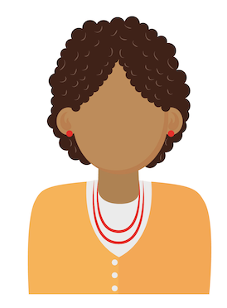
Real and nominal interest rates
Let’s imagine that inflation is at 5% and Zara has £1,000 in a savings account with a 5% interest rate.
Although at the end of the year she has £1,050 in her account because interest is added (£1,000 x 1.05 = £1,050), that amount of money will be able to buy her the same amount of items as a year ago, because prices have risen by the same amount!

Slide 29
Case studies
We’re going to read about three people’s situations.
Your job is to assess the effect of changing interest rates on each individual.
Take into account their financial situation and also other lifestyle factors that may be relevant.
Resource 1 - Interest rates: Case studies

Slide 30
Case studies | Neeta
Interest rates go down.
Is this a benefit or drawback?
Explain why.
I take the train and bus to work every day but it can take me over an hour to get in. I’ve just passed my driving test and, if I drive to work, I’ll be able to get there in less than 30 minutes! This means that I have more downtime and can sometimes fit in a babysitting job.
I can’t afford to buy a car outright but I may be able to take out a lease, which is like a long-term rental agreement, as I’ve been saving up over the past 5 years.
The way the lease works is that I effectively rent a car for an agreed time period and pay back a monthly fee plus interest each month.
Benefit
Drawback
Notes:
Delivery instruction
Read aloud the scenario as a class. Ask students to discuss whether they think that the effect of the interest change will be a benefit or drawback to the character before holding a class vote. Invite student feedback before sharing the response on the following slide.

Slide 31
Case studies | Neeta
Interest rates go down.
Is this a benefit or drawback?
Explain why.
I take the train and bus to work every day but it can take me over an hour to get in. I’ve just passed my driving test and, if I drive to work, I’ll be able to get there in less than 30 minutes! This means that I have more downtime and can sometimes fit in a babysitting job.
I can’t afford to buy a car outright but I may be able to take out a lease, which is like a long-term rental agreement, as I’ve been saving up over the past 5 years.
The way the lease works is that I effectively rent a car for an agreed time period and pay back a monthly fee plus interest each month.
Benefit
Drawback
Lower interest rates mean that Smita can find a cheaper deal on the lease. Her wellbeing may improve as she has more time not travelling and her finances may also improve if she takes up more babysitting work. If interest rates are lower, she may also be able to lease a more premium car, or save the money that she was expecting to spend.

Slide 32
Case studies | Jorge
Interest rates go down.
Is this a benefit or drawback?
Explain why.
I used to work as an Account Manager at a pharmaceuticals firm but I’m now retired.
Having put away a chunk of money every month into my employment pension when I was working, I now live comfortably off my pension and have put a lot of my money into a savings account with the bank, hoping that the interest will make my money grow.
I enjoy eating out and I’m looking to save up for a little longer to refurbish my kitchen.
Benefit
Drawback
Notes:
Delivery instruction
Read aloud the scenario as a class. Ask students to discuss whether they think that the effect of the interest change will be a benefit or drawback to the character before holding a class vote. Invite student feedback before sharing the response on the following slide.

Slide 33
Case studies | Jorge
I used to work as an Account Manager at a pharmaceuticals firm but I’m now retired.
Having put away a chunk of money every month into my employment pension when I was working, I now live comfortably off my pension and have put a lot of my money into a savings account with the bank, hoping that the interest will make my money grow.
I enjoy eating out and I’m looking to save up for a little longer to refurbish my kitchen.
Interest rates go down.
Is this a benefit or drawback?
Explain why.
Benefit
Lower interest rates mean that Jorge will be earning less interest from his money with the bank. He might need to save for a longer period of time in order to be able to refurbish his kitchen. He may also make the decision to eat out less and make more meals at home in order to cut costs. This may be a short term trade off for a longer term benefit of a nicer kitchen. Alternatively, it will be cheaper for Jorge to take out a loan to refurbish his kitchen.
Drawback

Slide 34
Case studies | Sam
Interest rates go up.
Is this a benefit or drawback?
Explain why.
I am an estate agent meaning that my job is to sell homes to people. I enjoy my work, especially when I find my clients their dream home.
I earn an annual salary as well as make commission of 5%. This means that I make 5% extra on the sale of any properties that I sell.
Benefit
Drawback
Notes:
Delivery instruction
Read aloud the scenario as a class. Ask students to discuss whether they think that the effect of the interest change will be a benefit or drawback to the character before holding a class vote. Invite student feedback before sharing the response on the following slide.

Slide 35
Case studies | Sam
Interest rates go up.
Is this a benefit or drawback?
Explain why.
I am an estate agent meaning that my job is to sell homes to people. I enjoy my work, especially when I find my clients their dream home. I earn an annual salary as well as make commission of 5%.
This means that I make 5% extra on the sale of any properties that I sell.
Benefit
Lower interest rates mean more people are likely to want to take out a mortgage (type of loan) to buy a house because they will have to pay back lower rates of interest. They will benefit less from having their money in savings accounts with the bank. This means more houses are likely to be sold making Sam’s job more exciting, and possibly increasing his commission and quality of life.
Drawback

Slide 36
Plenary
21
What are the three most important messages that you’ll take away from this lesson?
You have one minute to summarise what you have learnt today.
No hesitating, repeating or long pauses.

Slide 37
By the end of the session, I will be able to:
Describe what is meant by ‘the economy’
State the government’s main economic objectives
Explain how interest rate changes affect people and their lives

Slide 38
Any questions?
?

Slide 39
Services available for people who have concerns about their personal finances
Citizens Advice – Debt and Money – This resource contains links to advice on a number of topics, including financial difficulties, cost of living and communicating with creditors.
National Debtline – Debt and Money – a debt advice charity run by the Money Advice Trust, offering a free and confidential debt advice service.
Childline Helpline 0800 1111
At school, you can speak with an adult you trust.
This could be your form tutor, head of year or the school’s safeguarding officer.

Slide 40
Links to learn more!
Articles to extend learning
https://www.bankofengland.co.uk/explainers/what-is-the-economy
https://www.ons.gov.uk/economy/nationalaccounts/articles/dashboardunderstandingtheukeconomy/2017-02-22
https://www.imf.org/en/Publications/fandd/issues/Series/Back-to-Basics/gross-domestic-product-GDP
Please visit the FLIC learning hub - https://ftflic.com/learning-hub/ for further resources

