Slide 1
Preparing for my financial future
This session is aimed at key stage five (recommended for Year 12 and 13)

Slide 2
Unit outline
Session 1 | Session 2 | Session 3 | Session 4 | Session 5 | Session 6
Managing Student Finance | Borrowing and Debt | Property - Renting and Buying | Cryptocurrency Risk and Reward | Money and Well-being | Decision- Making Financial literacy in the curriculum

Slide 3
Having a respectful learning environment
We will listen to each other respectfully
We will avoid making judgements or assumptions about others
We will comment on what has been said, not the person who has said it
We won’t put anyone on the spot and we have the right to pass
We will not share personal stories or ask personal questions

Slide 4
4
Session 2
Borrowing and debt

Slide 5
By the end of the session, I will be able to:
Recognise situations that can lead to people being in debt (planned and unplanned borrowing)
Analyse the benefits and risks of borrowing money
Assess the best borrowing option

Slide 6

Reasons for Borrowing
Activity
Zara is thinking about borrowing money by taking out a loan.
Create a mind map showing why people may borrow money.
Of the reasons listed, which are planned and which are unplanned?
Things to consider:
What events may occur in a person’s life?
Are there any common expensive purchases?
What may people not have expected to happen?
Notes:
Delivery Instructions
Students should focus on specific instances in which people may get into debt.
Teacher Explanation
Expected Student Feedback:
People may borrow money because:
They can’t afford to buy an item that they want or need
It’s common to borrow to buy a house. This is known as a mortgage
Planned borrowing is usually manageable and has been accounted for in budgeting. It may include: vehicle finance i.e. buying a car or taking out a mortgage
Unplanned borrowing is usually open-ended and can be expensive. It may include: when someone is hit with an unexpected bill such as fixing a home appliance if someone doesn’t have emergency savings
People may get into debt due to:
Bills and expenses that have been unaccounted for
Falling into unemployment/low income
Poor financial management
Declining health
Large purchases (e.g house or car)
Education (student loan)

Slide 7

Cultural considerations - reminder
Borrowing money is a personal decision which can be based on a number of factors and circumstances.
For some people borrowing money is not an option as it is not aligned with their values or religious customs.
As a matter of faith a Muslim cannot lend money to, or receive money from someone and expect to benefit – interest (known as riba) is not allowed.
To make money from money is forbidden – wealth can only be generated through legitimate trade and investment in assets.

Slide 8
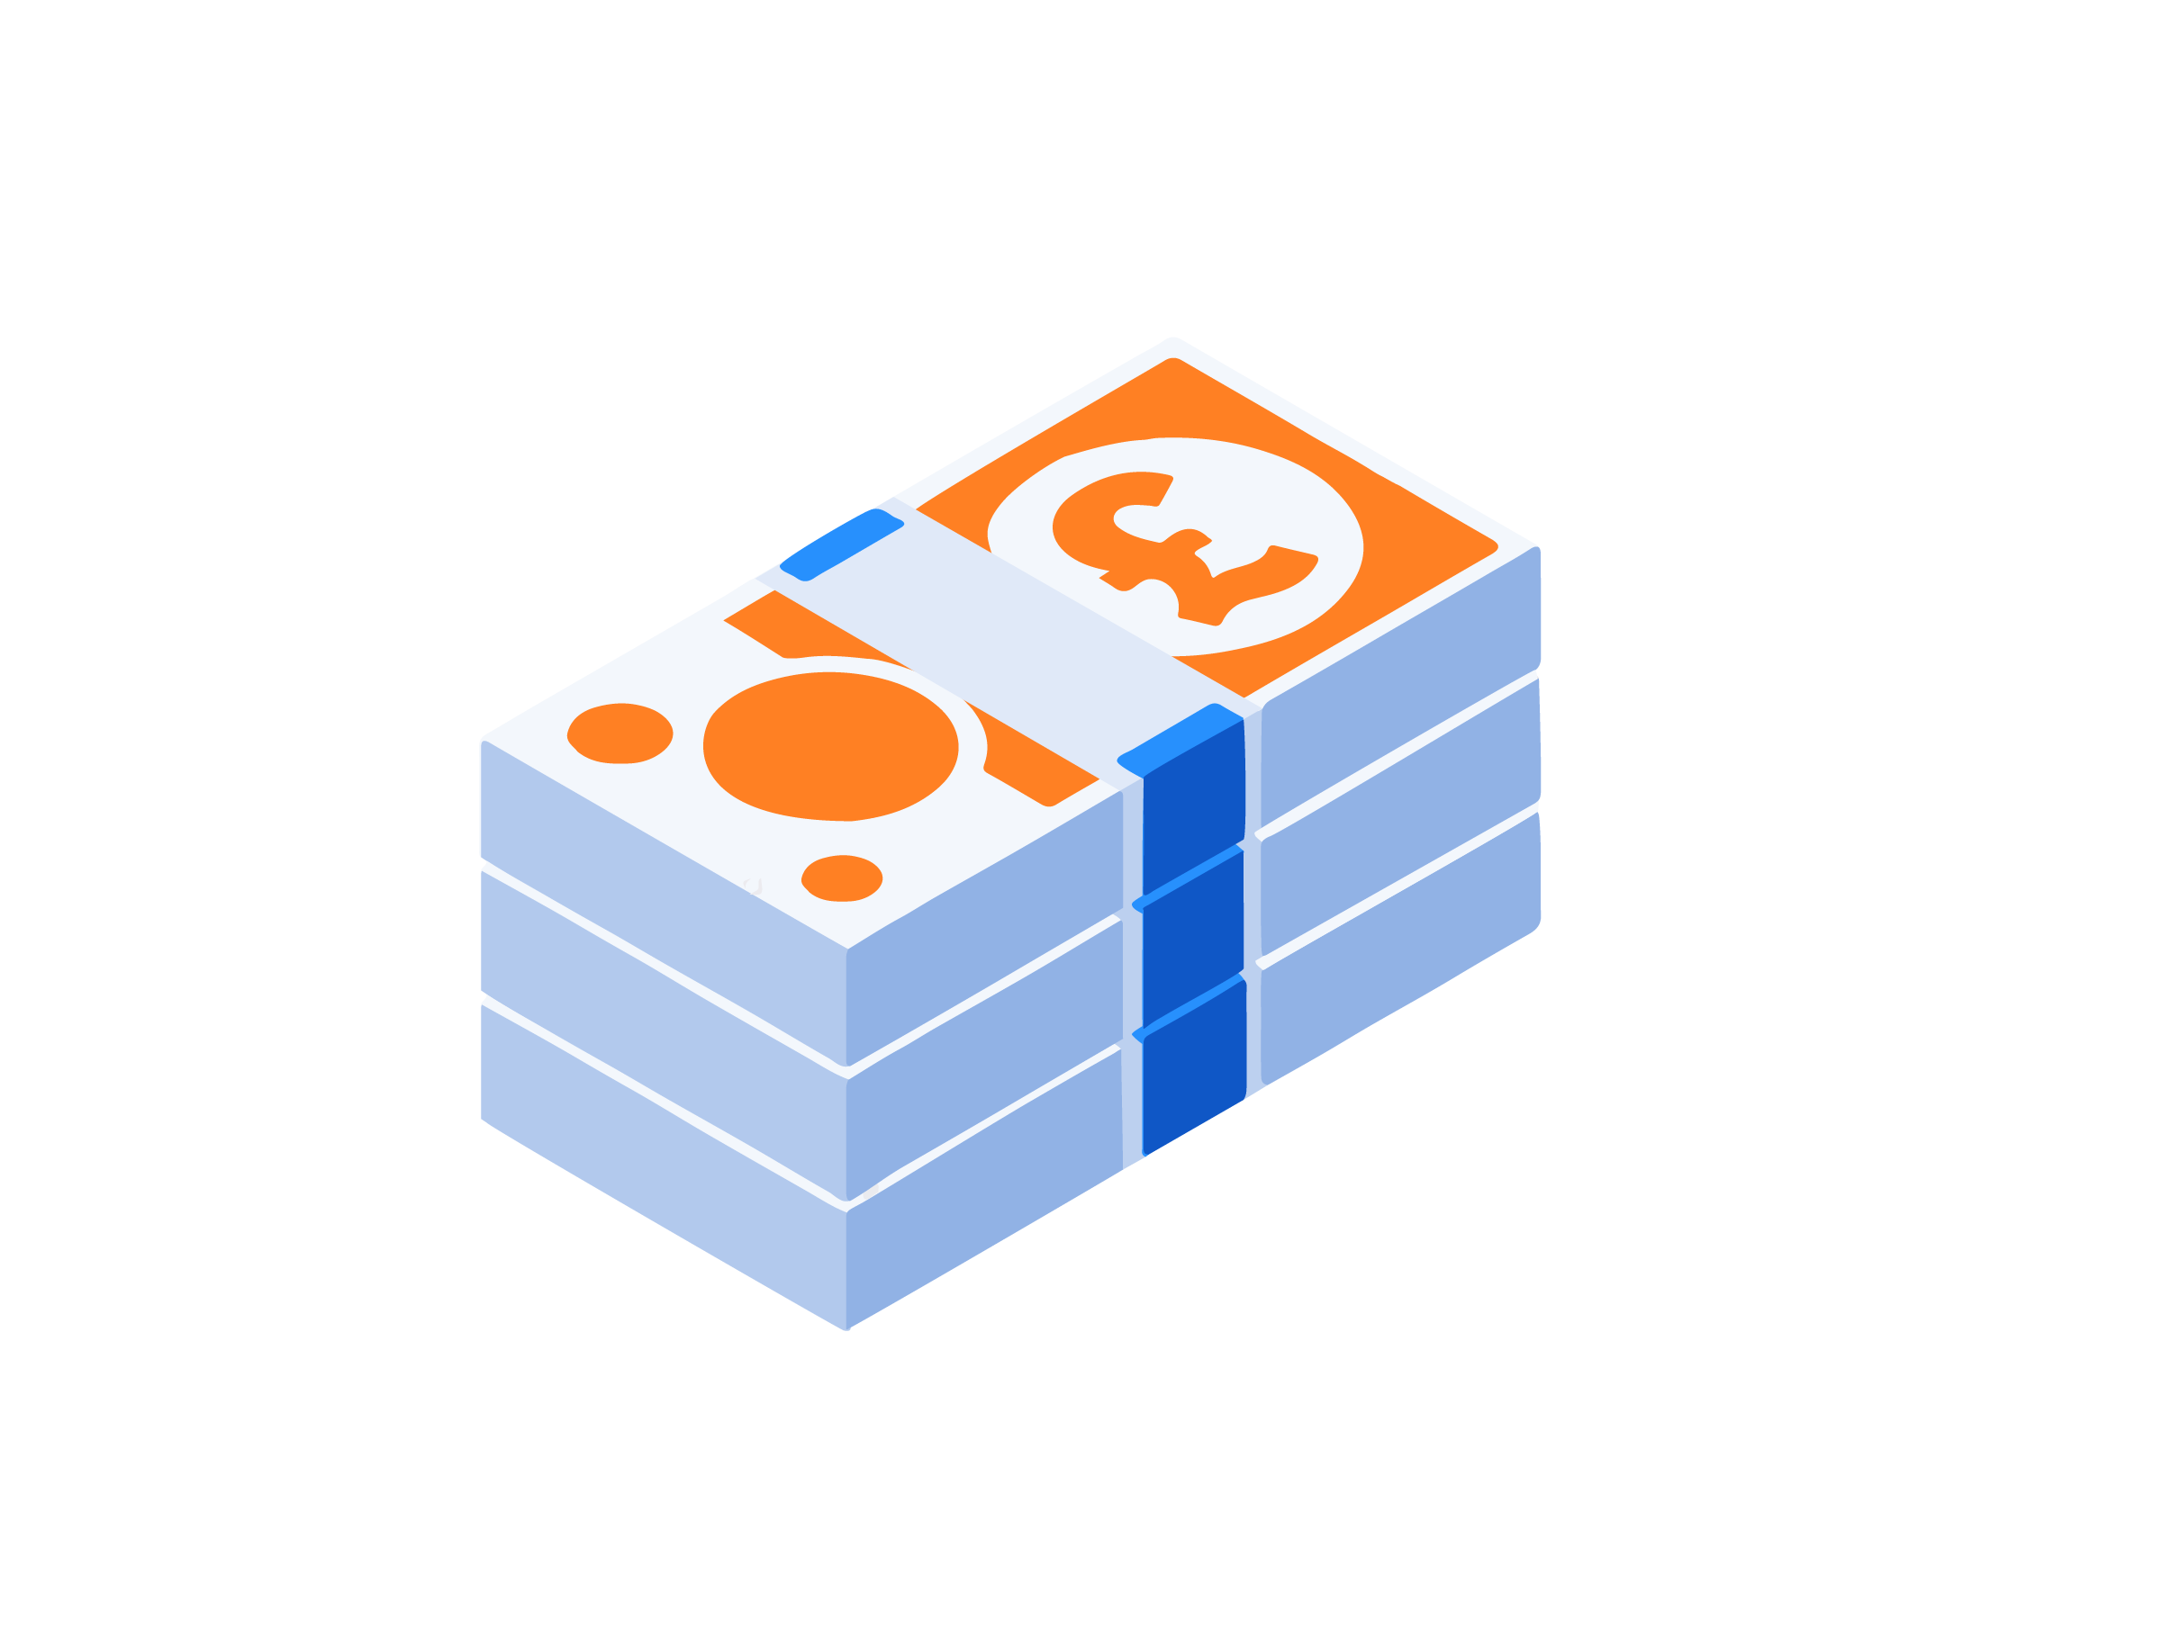
Money mindsets
In pairs, discuss the extent to which you agree with the following statement.
Agree Disagree
“It is never a good idea to borrow money”
Notes:
Teacher delivery
If mini whiteboards are available, students can respond on these to gage prior understanding / pick diverse views to explain they're thinking (can still be pair work)
Prompt Questions
What example have we looked at, where it’d be very difficult to make purchases without borrowing? What is the alternative in those situations? Is that realistic?
Teacher Explanation
Expected Student Feedback
Some students may have an aversion to borrowing, which can sometimes be due to their upbringing. In addition to this, Islamic teaching encourages Muslims to avoid debt as much as possible. As such, some students may agree with the statement in this slide. In this case, it is important to make clear that we are speaking in a purely financial sense.
Teacher Script
Points to elicit in this slide are as follows:
Debt is not intrinsically a bad thing. It is often the only way people can reach a certain standard of living. Use buying a house as an example. It is estimated the 25m current homeowners have used a mortgage in some form to purchase a house
The key to making debt work for you is ensuring you are able to make repayments. This means being realistic before you take on any debt, and factoring how changing economic conditions may alter your ability to repay your debt.

Slide 9
Money mindsets
In pairs, discuss the extent to which you agree with the following statement.
Agree Disagree
“Unplanned borrowing is always a bad idea”
Notes:
Prompt Question
Imagine you won’t be paid until next week, and your boiler breaks down, leaving you with no heating or hot water. What options will you have? How feasible are these?
Teacher Explanation
Expected Student Feedback
From the first task, some students may have developed the view that unplanned borrowing = bad, and planned borrowing = good. As such, responses to this statement may reflect this
Teacher Script
Points to elicit in this slide are as follows:
Whilst unplanned debt is not ideal, it may still be the most beneficial option for some people.
The key here is to ensure as much as possible that the debt being taken on is manageable (e.g. avoiding payday loans, which will be discussed later) and only taken on if absolutely necessary.

Slide 10
Money mindsets
In pairs, discuss the extent to which you agree with the following statement.
Agree Disagree
“As long as I plan my borrowing, I won’t have any issues”
Notes:
Prompt Question
What unforeseen events might impact someone’s ability to pay their mortgage?
How likely is it that these would have been planned for?
Teacher Explanation
Expected Student Feedback
The general tone of the discussion should lead to students potentially thinking that planned borrowing = good, so there may be agreement with the statement. Again things are more nuanced and should be portrayed to the students using the information below.
Teacher Script
Points to elicit in this slide are as follows:
If you are to borrow money, you should certainly plan it ahead of time, considering your ability to pay, and how this may change as economic and personally circumstances change.
However, not everything can be planned for, so just because borrowing has been planned, it doesn’t mean things will be plane sailing

Slide 11
By the end of the session, I will be able to:
Recognise situations that can lead to people being in debt (planned and unplanned borrowing)
Analyse the benefits and risks of borrowing money
Assess the best borrowing option

Slide 12




‘Good’ vs ‘bad’ debt
Create the table below in your notes.
As we watch the video clips, make a note of what is considered ‘good’ debt and what is considered ‘bad’ debt.
What is ‘good’ debt? | What is ‘bad’ debt?

Slide 13
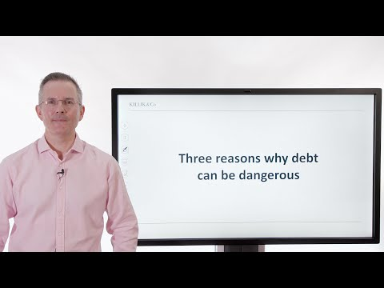
What is ‘good’ debt?’
Notes:
Teacher Explanation
Expected Student Feedback
Benefits of Borrowing
Can be useful in emergencies
Allows for purchases that otherwise would not be possible (e.g. houses) but only beneficial if planned out, considering future payments
Useful when they enable you to progress in life, e.g. student loans.

Slide 14
What are the risks of borrowing?
Notes:
Teacher Explanation
Expected Student Feedback
Risks of Borrowing:
Could lead to a trap, where more and more borrowing is required to maintain the same lifestyle
Compounding can drastically increase the amount owed, especially if it not paid off over time.
Opportunity cost: Paying off debt takes away the opportunity to invest in long term assets, which may have benefited from strong growth rates

Slide 15
What happens with ‘compounding?’

Slide 16
Compound interest is extremely powerful: Effectively we’re calculating interest on top of interest!
Money borrowed or saved grows faster and faster. If saving money in a bank, compounding helps money to grow. If taking out a loan with interest (borrowing money) compounding leads to the loan growing and growing, meaning there is an increasing amount to pay back over time.
You can use the compound interest loan calculator to see this in action.
Notes:
Addition information
You can use the compound interest loan calculator to see this in action and watch the BBC Teach video to learn more.

Slide 17
‘Good’ vs ‘bad’ debt
What is ‘good’ debt? | What is ‘bad’ debt?
Can be useful in emergencies Allows for purchases that otherwise would not be possible (e.g. houses) but only beneficial if planned out, considering future payments Useful when they enable you to progress in life, e.g. student loans. | Could lead to a trap, where more and more borrowing is required to maintain the same lifestyle Compounding can drastically increase the amount owed, especially if it not paid off over time. Opportunity cost: Paying off debt takes away the opportunity to invest in long term assets, which may have benefited from strong growth rates

Slide 18
By the end of the session, I will be able to:
Recognise situations that can lead to people being in debt (planned and unplanned borrowing)
Analyse the benefits and risks of borrowing money
Assess the best borrowing option

Slide 19
Types of Loans
There are many types of loans available, but they all fall into two broad categories
Secured Loans
Secured loans have an asset* linked to them, such as a home. In the event that someone is unable to repay the loan, the lender can repossess and sell the asset in order to regain the amount they lent.
Unsecured loans
Loans in which you do not need to provide an asset as security.
These involve borrowing a lump sum and paying the loan back in installments (chunks) over time.
Discussion
Which of these loans would you expect to have lower interest rates?
Explain your reasoning to your partner
* Asset - valuable item
Notes:
Teacher Explanation
Secured loans tend to offer both lower interest rates and higher loan amounts, simply because the risk to the lender is lower, as they can recoup a lot of (if not all) the money in the event you fail to repay it.

Slide 20
Types of Loans
There are many types of loans available, but they all fall into two broad categories
Secured Loans
Secured loans have an asset* linked to them, such as a home. In the event that you’re unable to repay the loan, the lender can repossess and sell the asset in order to regain the amount they lent.
Unsecured loans
Loans in which you do not need to provide an asset as security.
These involve borrowing a lump sum and paying the loan back in installments (chunks) over time.
Secured loans tend to offer both lower interest rates and higher loan amounts.
This is because the risk to the lender is lower, as they can recoup a lot (if not all) of the money in the event that the loan isn’t repaid.
* Asset - valuable item
Notes:
Teacher Explanation
Secured loans tend to offer both lower interest rates and higher loan amounts, simply because the risk to the lender is lower, as they can recoup a lot of (if not all) the money in the event you fail to repay it.

Slide 21
Types of Loans
Activity
Which of these loans are secured, and which are unsecured? Explain your reasoning
Mortgages
A loan used to purchase a property. The lender has the right to repossess the property if you fail to make payments.
Personal Loans
A type of loan that allows flexible use, short to medium term repayment, and relatively quick funding.
Vehicle Finance
A loan used to purchase a vehicle. You do not own the vehicle until the loan is paid off.
Buy Now Pay Later
It’s a form of short-term financing, allowing someone to spread costs over time. However, if a payment is late or missed, very high rates of interest may be charged.
Guarantor Loan
Similar to a personal loan, but uses a third party to guarantee to pay the loan in case the borrower fails to do so.
Payday Loans
A short-term loan with high interest lent on the assumption that the borrower will repay the loan upon receiving their next wages.
Notes:
Homeowner Loans
Homeowners are able to borrow a certain percentage of the equity they have in their home. Usually used to make home improvements or fund large purchases.

Slide 22
Types of Loans
Activity
Which of these loans are secured, and which are unsecured? Explain your reasoning
Mortgages
A loan used to purchase a property. The lender has the right to repossess the property if you fail to make payments.
Personal Loans
A type of loan that allows flexible use, short to medium term repayment, and relatively quick funding.
Vehicle Finance
A loan used to purchase a vehicle. You do not own the vehicle until the loan is paid off.
UNSECURED
SECURED
SECURED
Buy Now Pay Later
It’s a form of short term financing, allowing someone to spread costs over time. However, if a payment is late or missed, very high rates of interest may be charged.
Guarantor Loan
Similar to a personal loan, but uses a third party to guarantee to pay the loan in case the borrower fails to do so.
Payday Loans
A short term loan with high interest lent on the assumption that the borrower will repay the loan upon receiving their next wages.
UNSECURED
UNSECURED
UNSECURED

Slide 23
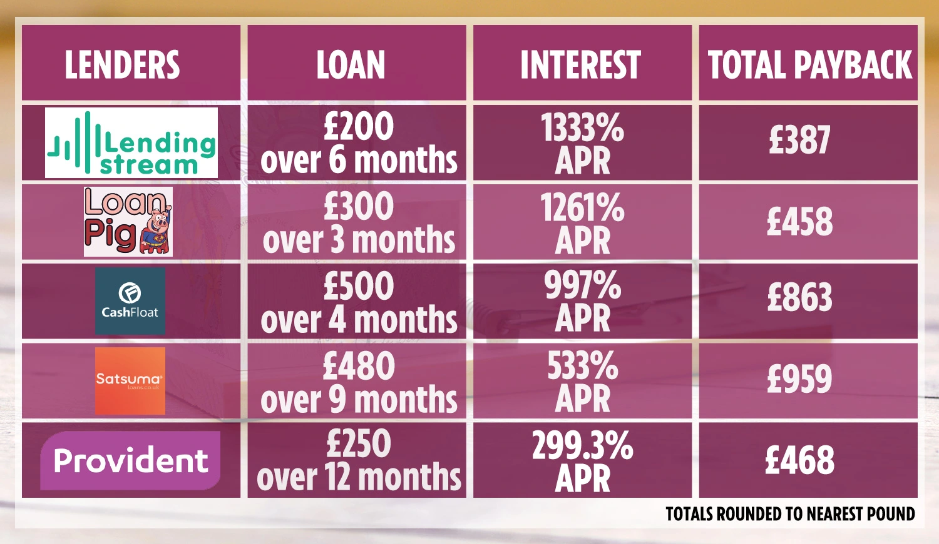
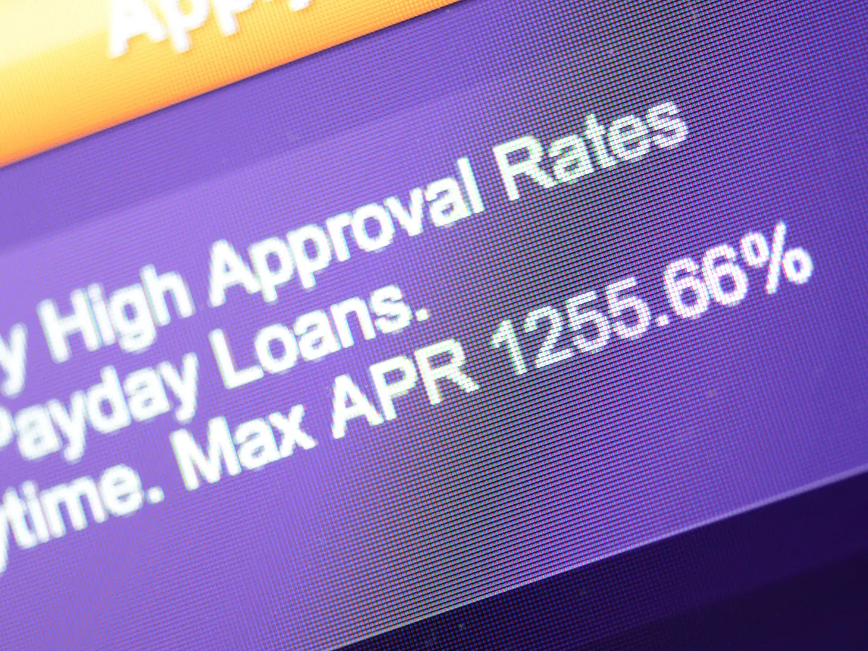
Payday Loans
Payday loans work slightly differently to other loans
As they’re meant to be paid back at the next pay day, their terms tend to be shorter
They’re seen as a form of emergency borrowing, and therefore have much higher interest rates
You’ll often see their APR (Annual Percentage Rate) interest rate advertised. This is the interest charged on a loan if held for a year, including other fees
Over a year, the average annual percentage interest rate of charge (APR) could be up to 1,500% compared with 22.8% APR for a typical credit card
Learn more from Money Helper here
Notes:
Teacher explanation
Payday loans are slightly different, as the term in the example is 1 month. As the interest rate is APR, students simply need to divide the rate by 12 to find the monthly rate.
This gives 105%. As a decimal, this becomes 1.05
Payday Loans: 1,000(1+1.05)^1 = £2,050

Slide 24
Pros and cons of taking out a loan from a bank
THINK-PAIR-SHARE
What might be the advantages and disadvantages of taking out a bank loan?
Advantages
Disadvantages
Some loans allow the purchase of items that improve living standards, like a house (mortgage) or car (vehicle loan).
Interest rates are often fixed for the term of the loan, which gives a degree of certainty over the cost.
Some loans allow early repayment, without penalties, which will reduce the amount of interest paid.
Loans with low interest rates allow someone to borrow relatively large sums for a relatively low cost.
Missing payments on secured loans can result in somebody losing assets (something a person owns that holds value).
Missing payments also negatively affects credit ratings (the ability to get a mortgage or take out a future loan).
Using loans can encourage people to get into a bad habit of living beyond their means.
Loans will never offer 0% interest, but you may get this from a credit card, though the amount borrowed and 0% offer period is likely to be lower than with a loan. So taking out a loan will incur a cost.

Slide 25

Assessing different financing options
Karim is looking to buy a brand new laptop costing £1,000. On the next slide you’ll see four different borrowing options.
Explain the pros and cons of each type of borrowing
Is there one best borrowing option for Karim?
Are there alternative ways Karim can get a laptop?
What is APR?
APR stands for annual percentage rate. It is used to show the cost of borrowing.
This refers to the yearly interest rate when interest is added to a loan.
It’s expressed as a percentage of the amount borrowed. It takes into account the interest rate and additional fees.

Slide 26



What’s the best buy?
Borrowing money usually incurs a cost. This is through interest which is the amount the lender charges for letting Karim borrow the money.
Interest on borrowing is often referred to as Annual Percentage Rate (APR). The higher the APR, the more expensive the borrowing will be.
Other factors will also affect how much is paid overall: the longer the borrowing term, the more will be paid.

Slide 27
What’s the best buy?
See Resource 1
Karim is looking to buy a brand new laptop costing £1,000.
Explain the pros and cons of each type of borrowing.
Is there one best borrowing finance option for Karim?
Are there alternative ways Karim can get a laptop?
A. Buy now, pay later!
Take this laptop home today and pay for it in 3 instalments over a three-month period
If payment is late a £200 charge will be added and late payment will affect your credit score
Total payable if paid on time = £1,000
Total payable if paid late = £1,200
B. It’s yours for £700 today
Then only 6 monthly payments of £35.81
25% APR
Total payable = £1,020
C. Only pay £200 now!
Then 12 monthly payments of £77.95
29.9% APR
Total payable = £1,135
D. Only pay £200 today!
You’ll then pay just £48.91 monthly for
24 months
39.9% APR
Total payable = £1,373
Notes:
https://www.thecalculatorsite.com/finance/calculators/loancalculator.php?utm_content=cmp-true
Teacher explanation
There may be no right or wrong answer. It depends on what Karim can afford now and how much he is willing to pay in the future. Karim needs to be careful and not be overconfident on his ability to pay back a larger sum in the future unless for example he has a job lined up.
However, it’s important to note that comes with risk
Borrowing money usually incurs a cost. This is through interest which is the amount the lender charges for letting Karim borrow the money.
Interest on borrowing is often referred to as Annual Percentage Rate (APR). The higher the APR, the more expensive the borrowing will be.
Other factors will also affect how much is paid overall: the longer the borrowing term, the more will be paid.

Slide 28
What’s the best buy?
Buy now, pay later!
Take this laptop home today and pay for it in 3 installments over a three-month period
If payment is late a £200 charge will be added and late payment will affect your credit score
Total payable if paid on time = £1,000
Total payable if paid late = £1,200
Although Karim may not need to pay back any interest, there is a risk that if he can’t afford the laptop after three months, he will have to pay a £200 fee. He should only choose this option if he is sure of his repayment plan.
If his repayments are late, this will also affect his credit score meaning his ability to take out a loan in the future.
Importantly, for now, buy now pay later is an unregulated sector so money isn’t protected under Section 75, which credit card payments are. Section 75 laws mean credit card providers must protect purchases over £100 for free. Learn more here.
Karim is looking to buy a brand new laptop costing £1,000.
Explain the pros and cons of each type of borrowing.
Is there one best borrowing finance option for Karim?
Are there alternative ways Karim can get a laptop?
Notes:
Teacher explanation
There may be no right or wrong answer. It depends on what Karim can afford now and how much he is willing to pay in the future. Karim needs to be careful and not be overconfident on his ability to pay back a larger sum in the future unless for example he has a job lined up.
However, it’s important to note that comes with risk
Borrowing money usually incurs a cost. This is through interest which is the amount the lender charges for letting Karim borrow the money.
Interest on borrowing is often referred to as Annual Percentage Rate (APR). The higher the APR, the more expensive the borrowing will be.
Other factors will also affect how much is paid overall: the longer the borrowing term, the more will be paid.

Slide 29
What’s the best buy?
B. Only pay £200 now!
Then 12 monthly payments of £76.60
29.9% APR
Total payable = £1,119
If Karim can’t afford the laptop upfront this is a possible option. However, he should also consider a cheaper option or waiting a bit, to be able to pay more upfront.
The payment term of 12 months means that it might be affordable for him to pay £76.60 per month; this is higher than the monthly rate if paid back over 24 months, but the overall cost of £119 (the cost to borrow on top of the price of the laptop) is lower overall which is a good thing.
Karim needs to ensure that he has a repayment plan in order to meet these monthly payments.
Karim is looking to buy a brand new laptop costing £1,000.
Explain the pros and cons of each type of borrowing.
Is there one best borrowing finance option for Karim?
Are there alternative ways Karim can get a laptop?
Notes:
Teacher explanation
There may be no right or wrong answer. It depends on what Karim can afford now and how much he is willing to pay in the future. Karim needs to be careful and not be overconfident on his ability to pay back a larger sum in the future unless for example he has a job lined up.
However, it’s important to note that comes with risk
Borrowing money usually incurs a cost. This is through interest which is the amount the lender charges for letting Karim borrow the money.
Interest on borrowing is often referred to as Annual Percentage Rate (APR). The higher the APR, the more expensive the borrowing will be.
Other factors will also affect how much is paid overall: the longer the borrowing term, the more will be paid.

Slide 30
What’s the best buy?
C. It’s yours for £700 today
Then only 6 monthly payments of £53.34
25% APR
Total payable = £1,020
Paying the majority of the expense upfront means the APR is lower than the option where less money is paid upfront.
This may be a good option if Karim can pay the majority of the cost upfront, but needs to borrow 30% to pay the rest off over 6 months.
The additional £20, ie the cost of borrowing, could be worth it for him.
Karim is looking to buy a brand new laptop costing £1,000.
Explain the pros and cons of each type of borrowing.
Is there one best borrowing finance option for Karim?
Are there alternative ways Karim can get a laptop?
Notes:
Teacher explanation
There may be no right or wrong answer. It depends on what Karim can afford now and how much he is willing to pay in the future. Karim needs to be careful and not be overconfident on his ability to pay back a larger sum in the future unless for example he has a job lined up.
However, it’s important to note that comes with risk
Borrowing money usually incurs a cost. This is through interest which is the amount the lender charges for letting Karim borrow the money.
Interest on borrowing is often referred to as Annual Percentage Rate (APR). The higher the APR, the more expensive the borrowing will be.
Other factors will also affect how much is paid overall: the longer the borrowing term, the more will be paid.

Slide 31
What’s the best buy?
Only pay £200 today!
You’ll then pay just £46.41 monthly for
24 months
39.9% APR
Total payable = £1,313
If Karim can’t afford the laptop upfront this is a possible but expensive option.
The payment term of 24 months (2 years) means that it might be affordable for him to pay £46.62 per month; this is lower than the monthly rate if paid back over 24 months, but the overall cost is higher. This finance option is costing Karim £313.
Karim also needs to ensure that he can meet these monthly payments.
Karim is looking to buy a brand new laptop costing £1,000.
Explain the pros and cons of each type of borrowing.
Is there one best borrowing finance option for Karim?
Are there alternative ways Karim can get a laptop?
Notes:
Teacher explanation
There may be no right or wrong answer. It depends on what Karim can afford now and how much he is willing to pay in the future. Karim needs to be careful and not be overconfident on his ability to pay back a larger sum in the future unless for example he has a job lined up.
However, it’s important to note that comes with risk
Borrowing money usually incurs a cost. This is through interest which is the amount the lender charges for letting Karim borrow the money.
Interest on borrowing is often referred to as Annual Percentage Rate (APR). The higher the APR, the more expensive the borrowing will be.
Other factors will also affect how much is paid overall: the longer the borrowing term, the more will be paid.

Slide 32

Does Karim have any other options?
Karim may wish to save money, potentially getting a part-time job, and pay the full amount upfront. This would reduce his risk and costs
He may also choose a cheaper or second-hand laptop, which is also better for the environment
Other borrowing options include:
  Getting a credit card with 0% interest. This is protected by Section 75
  Getting a 0% interest overdraft
Notes:
Teacher explanation
Key points to draw out
Consider whether the loan is secured or unsecured
Consider the term length and interest rate to work out how much she will have to pay over the lifetime of teh loan

Slide 33

What advice would you give?
Lucy is planning to borrow money to buy her first car.
What 3 things would you tell Lucy to consider when she’s taking out a loan (vehicle finance)?
Stretch - write a post informing other people about borrowing money
Notes:
Teacher explanation
Key points to draw out
Consider whether the loan is secured or unsecured
Consider the term length and interest rate to work out how much she will have to pay over the lifetime of teh loan

Slide 34
By the end of the session, I will be able to:
Recognise situations that can lead to people being in debt (planned and unplanned borrowing)
Analyse the benefits and risks of borrowing money
Assess the best borrowing option given different loan products

Slide 35
Any questions?
?
Notes:
https://www.moneyhelper.org.uk/en/everyday-money/types-of-credit/overdrafts-explained - Overdrafts
Buy Now Pay Later -

Slide 36

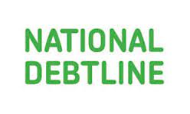

Services available for people who have concerns about their personal finances
Citizens Advice – Debt and Money – This resource contains links to advice on a number of topics, including financial difficulties, cost of living and communicating with creditors.
National Debtline – Debt and Money – a debt advice charity run by the Money Advice Trust, offering a free and confidential debt advice service.
Childline Helpline
0800 1111
At school, you can speak with an adult you trust.
This could be your form tutor, head of year or the school’s safeguarding officer.
Notes:
Read the moneysavingexpert debt problems guide
https://www.stepchange.org/
https://www.moneyhelper.org.uk/en/everyday-money/types-of-credit/overdrafts-explained

