Slide 1
Financial Literacy Curriculum
City of London Academy Trust | Year 12 Assembly

Slide 2
What is FLIC?
The Financial Times news group has set up a charity, Financial Literacy and Inclusion Campaign focused on building up the financial knowledge and skills of everyone in the UK, especially the people that don’t usually come across this information.
Flic have been working with Shoreditch Park to plan lessons that will improve your financial literacy.

Slide 3

Why is financial literacy important?

Slide 4
Why is financial literacy important?
We have been hearing about the cost of living in the news.
Due to national and international changes, many families are experiencing difficulties with their finances.
We want to make sure that you are equipped with the knowledge and skills that can help you to prepare and protect yourself financially in the future.

Slide 5
Having a respectful learning environment
Money is a very personal topic. People have different values about money and this might be influenced by their circumstances. During your financial literacy lessons, there are some important expectations for keeping our learning environment safe and respectful.
In every lesson;
We will listen to each other respectfully
We will avoid making judgements or assumptions about others
We will comment on what has been said, not the person who has said it
We won’t put anyone on the spot and we have the right to pass
We will not share personal stories or ask personal questions

Slide 6



Financing Higher Education
What are the costs that you will have to consider if you choose to go to university?

Slide 7
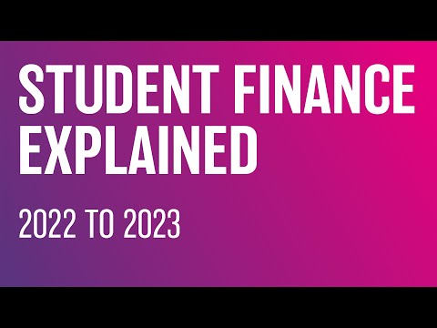
Financing Higher Education

Slide 8
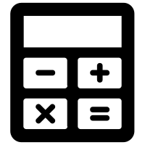
What will you be learning?
You will have six lessons on how to make financial decisions.
How to plan for my financial future
Session 1 | Session 2 | Session 3 | Session 4 | Session 5 | Session 6
Borrowing and debt | Managing student finance | Property - Renting and buying | Investing - risk and reward | Money and wellbeing | Researching your financial future
Don’t forget your calculator!

