Slide 1

How to protect my financial future
This session is aimed at key stage four (recommended for Year 11)

Slide 2
Unit outline
Session 1 | Session 2 | Session 3 | Session 4 | Session 5 | Session 6
Take home pay | Budgeting for the future | Savings | Investing for the long term | Insurance | Decision making - investment exercise

Slide 3
Having a respectful learning environment
3
We will listen to each other respectfully
We will avoid making judgements or assumptions about others
We will comment on what has been said, not the person who has said it
We won’t put anyone on the spot and we have the right to pass
We will not share personal stories or ask personal questions
If there is a question that you do not wish to ask aloud, you can write it on a post-it note which will be collected throughout the session and answered at the end

Slide 4
By the end of the session, I will be able to:
Describe the main salary deductions
Identify and explain key elements of a payslip
Calculate income tax for different job salaries

Slide 5
Session 1:
Take home pay
Taxes and deductions

Slide 6

Starter
Karim is a nurse. His gross annual salary is £31,000. The amount he actually takes home at the end of the year is £25,000, called his net pay.
Keywords
Gross pay
Net pay
Deductions
Income tax
National insurance
Pension
Progressive taxation
Can you name the reasons for the difference between Karim’s gross and net pay?
Gross pay - the total amount an employer pays to a member of staff
Net pay - the amount of money left after all regular deductions including income tax and national insurance, and any savings towards a pension
Notes:
Teacher explanation
Explain the a salary is subject to deductions and the first part (objective) of the lesson will name and define these in more detail.
Refer to key terms and definitions to clarify answers offered by students.

Slide 7
Wage slip deductions
For people in employment, there will be some deductions which are taken away from their gross pay.
These are the main ones, and we’ll focus on National Insurance and Income Tax in this lesson:
National Insurance
Income
Tax
Student loans
Pensions

Slide 8


Take home pay
Zara has been promoted and her salary has increased from £27,000 per year to £30,000.
How much will Zara get paid each month?
Congratulations Zara, you’ve been promoted
Job Title: Senior estate agent
Type of Employment: Employed,
full-time
Weekly hours/days worked:
5 days| 09:00 to 17:00
Wage or salary: £30,000
Watch this video
https://www.youtube.com/watch?v=wBVH1ao-ZsU
Notes:
Prompt questions (following the video) https://www.youtube.com/watch?v=wBVH1ao-ZsU
Is any of this familiar to you?
Is anything new to you?
What are your thoughts on deductions?

Slide 9

Speedy recap
What are 4 deductions that need to be considered when explaining the difference between gross and net pay?
Stretch - order them from which you think will be biggest to smallest in terms of amount.
Notes:
Delivery instruction
If available, use mini whiteboards

Slide 10
By the end of the session, I will be able to:
Describe the main salary deductions
Identify and explain key elements of a payslip
Calculate income tax for different job salaries

Slide 11

Can you guess…
When was income tax first introduced?
Income tax was first introduced in 1799 to raise money to fight the French Napoleonic wars.
What is tax spent on today?

Slide 12
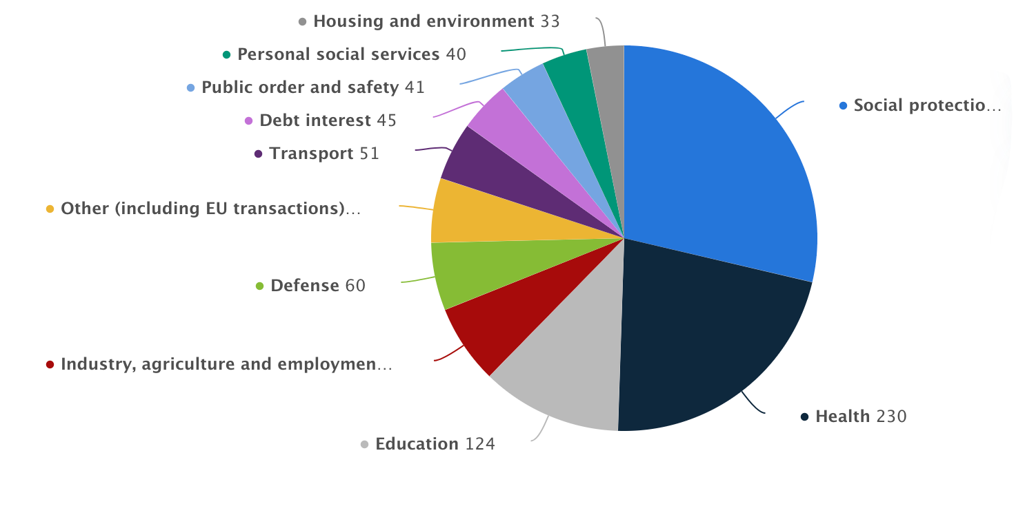
What is tax money spent on?
Match the main areas of public spending (listed in the box) to the segments on the pie chart
Health
Industry, agriculture and employment
Social protection (hospitals, home care)
Defence
Education
Transport
e
a
b
c
f
d
Challenge: Can you guess how much is spent on each area?
Notes:
Source: https://www.statista.com/statistics/298524/government-spending-in-the-uk/#:~:text=In%202021%2C%20the%20expenditure%20of,pensions%20and%20other%20welfare%20benefits.
Delivery instruction
Students to list the numbered items and write the corresponding letter

Slide 13
What is tax money spent on?
(F) Health
(C) Industry, agriculture and employment
(E) Social protection (hospitals, home care)
(B) Defence
(D) Education
(A) Transport
Open up the Statista link here to see the full amounts in billions!
Notes:
Teacher explanation
Explain to students, when opening up the link, that public sector expenditure means government spending.
Source:
https://www.statista.com/statistics/298524/government-spending-in-the-uk/#:~:text=In%202021%2C%20the%20expenditure%20of,pensions%20and%20other%20welfare%20benefits.

Slide 14
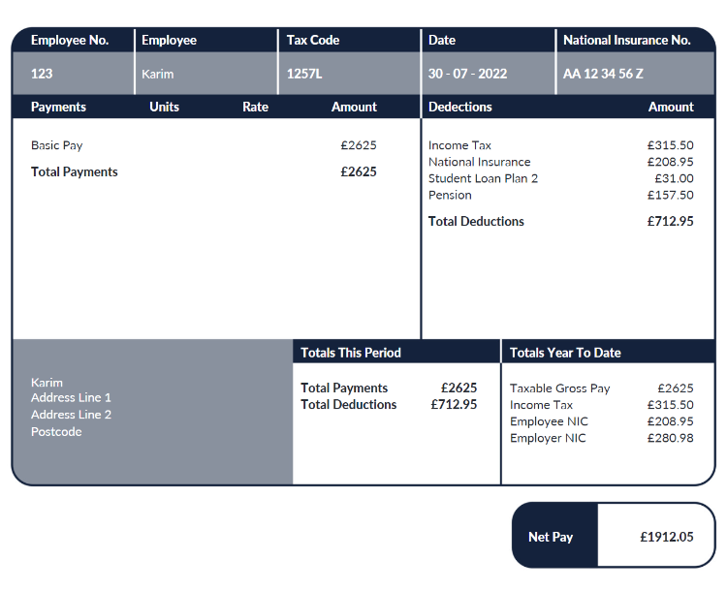
Understanding a payslip
What is gross pay?
______________________________________________________
What is national insurance?
_________________________________________________________________________________
What is a pension?
_________________________________________________________________________________
What is net pay?
______________________________________________________
What is income tax?
______________________________________________________
______________________________________________________
How much is a person allowed to earn before they are taxed?
______________________________________________________
Resource 1: Key features of a payslip
Notes:
Prompt question
Work out annual salary and write down

Slide 15
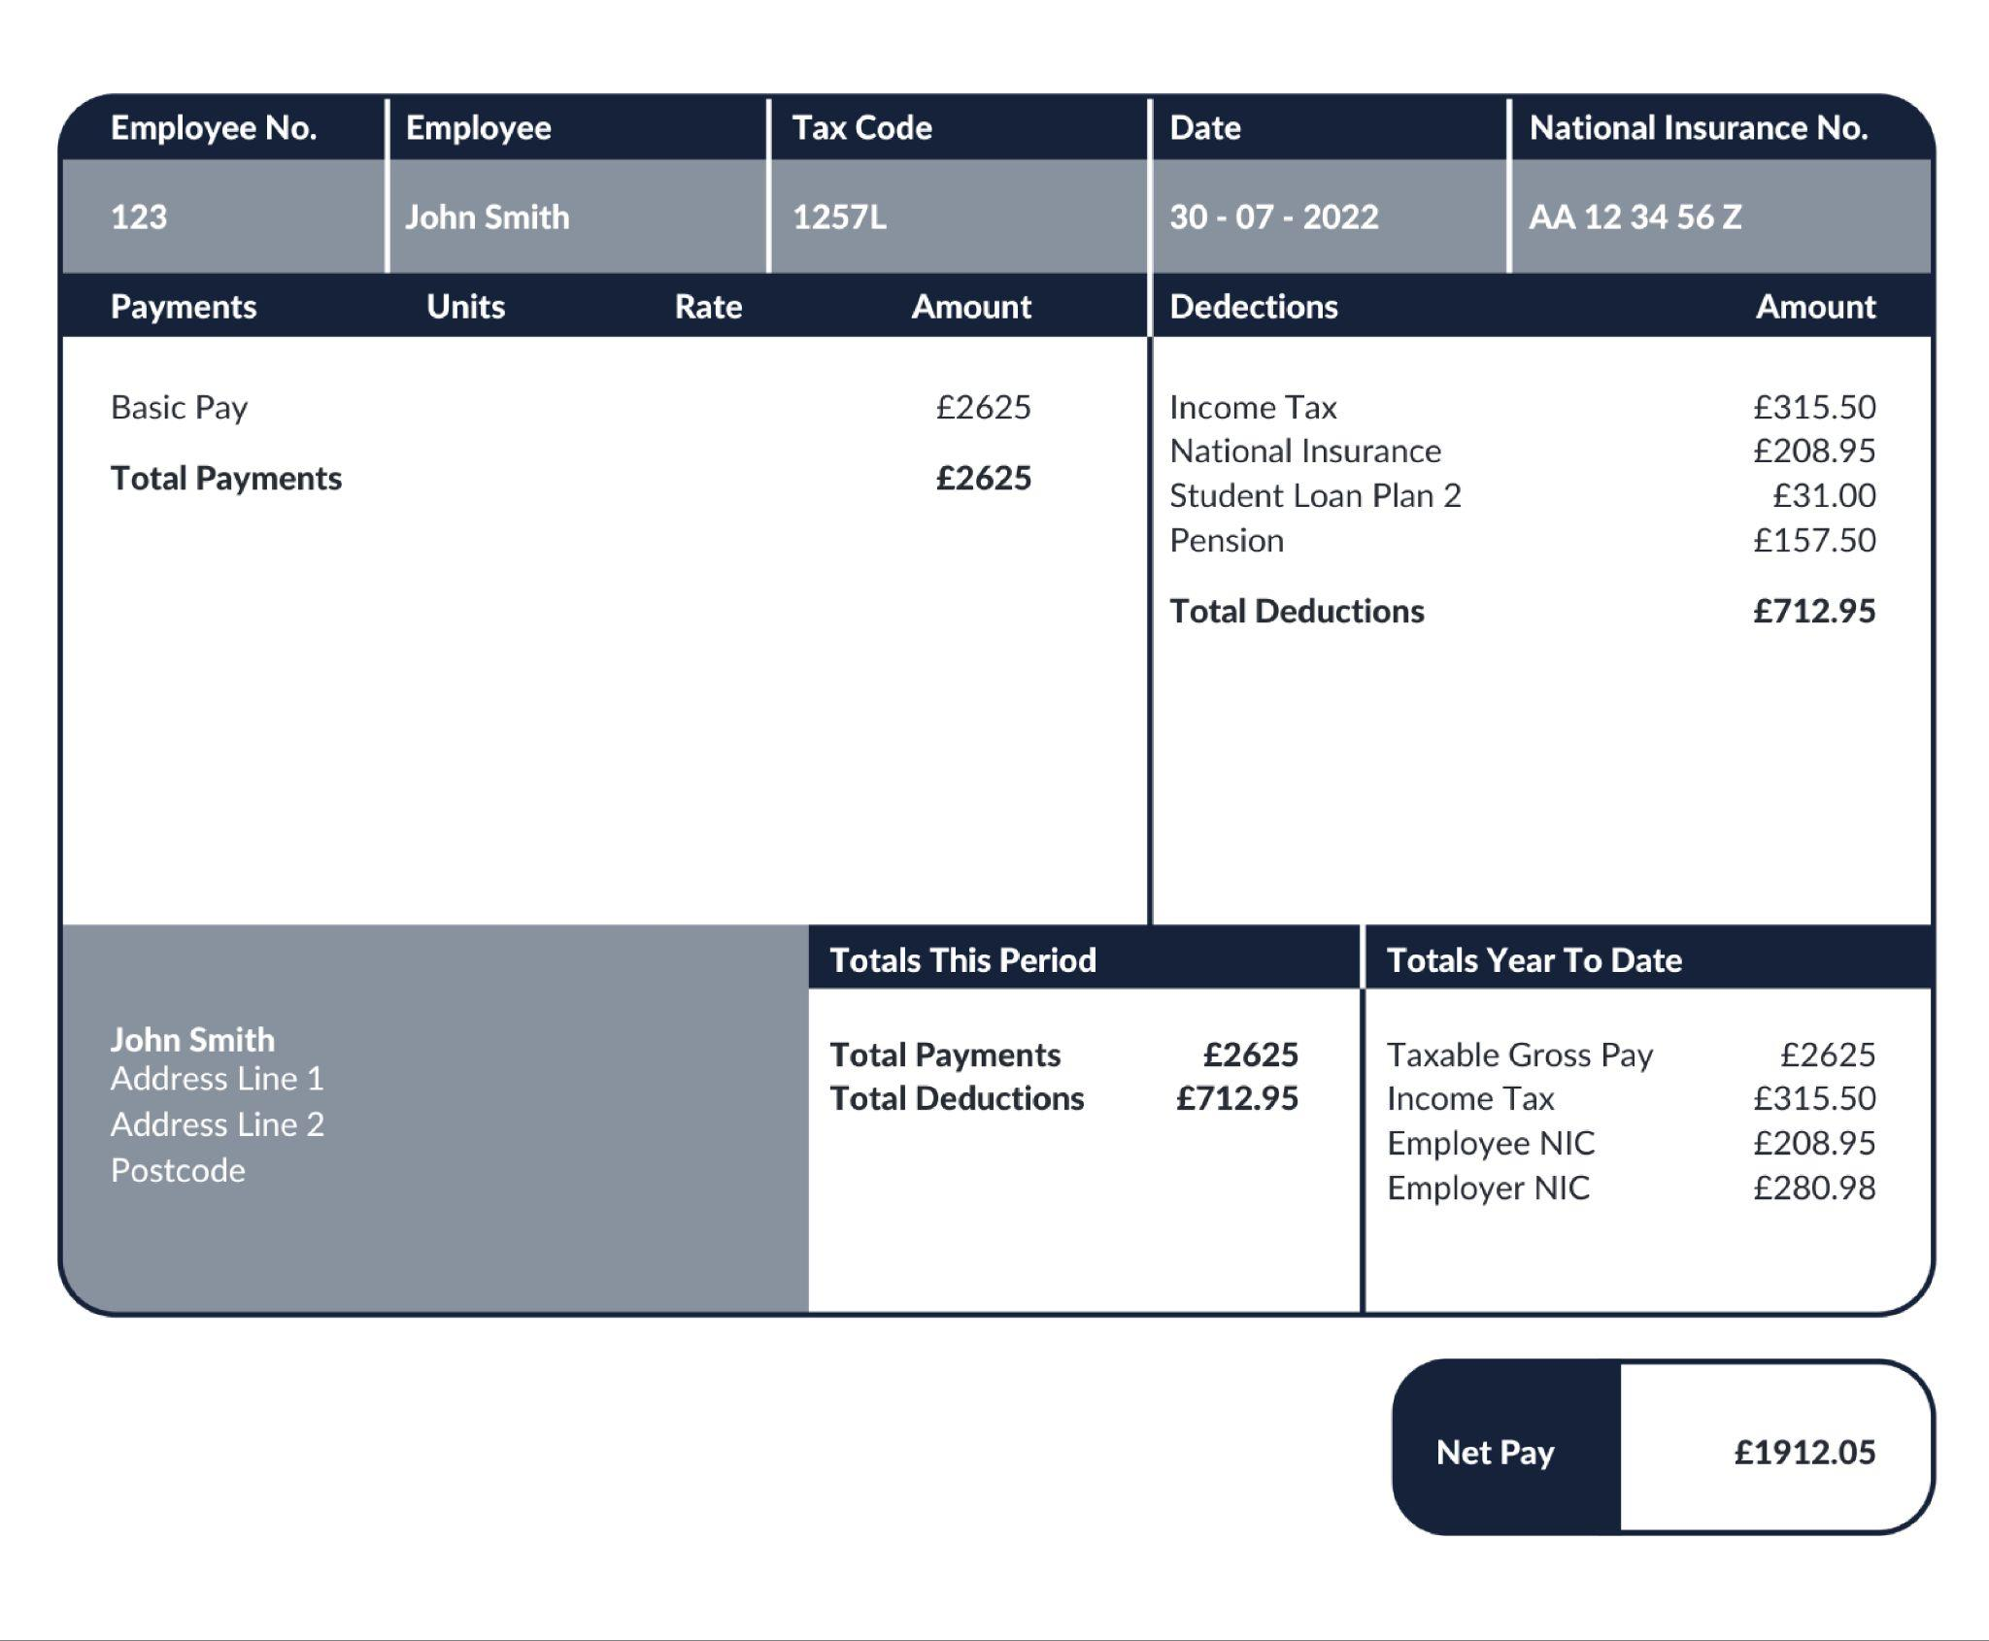
Understanding a payslip
Karim
What is this payslip
showing you?
Stretch: Can you write a formula to show how net pay is calculated?

Slide 16
Understanding a payslip
Today we’re going to learn about DEDUCTIONS.
You will have to pay INCOME TAX and NATIONAL INSURANCE.
You’re likely to have a PENSION and may have to pay back a STUDENT LOAN.

Slide 17
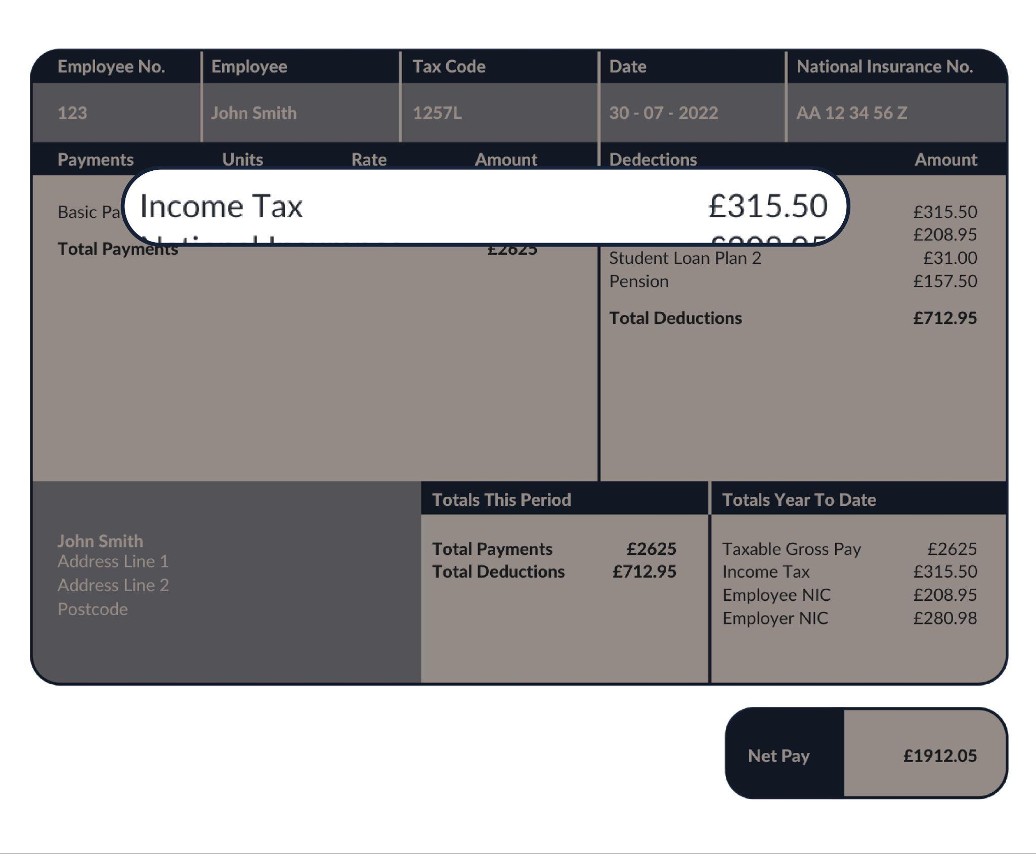
Starting with taxes
Income tax
Karim
Used for general public spending
The more a person earns, the more they pay
Why is it important to have this tax?
Karim

Slide 18
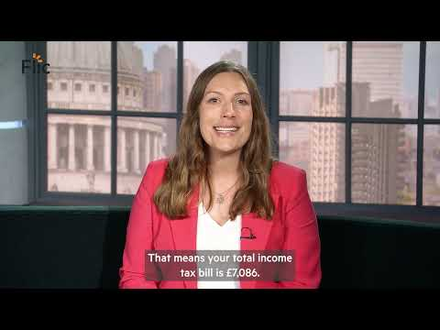
How does tax on earnings really work?
Write down main points you learn while watching the video about income tax and national insurance.
https://www.youtube.com/watch?v=rbLM-8jGki8&t=11s
Notes:
Teacher explanation
Key message in income tax https://www.youtube.com/watch?v=rbLM-8jGki8&t=11s
The more you earn, the more you pay

Slide 19

Income tax
Income tax
Key terms
Income tax = tax based on a person's earnings
Personal allowance = £12,570* (the amount a person can earn in a year before they pay any tax.
This is non-taxable earnings)
Tax rate = 20% (for those earning £12,571 to £50,270)
Total income tax for the year =
(Income - Personal Allowance) x 0.20 (this represents 20% tax rate)
Income tax is PROGRESSIVE. When a person earns more income they go up a tax band so their rate of tax on each extra pound goes up. The key is that when a person gets paid over a certain amount they only pay the higher level of tax on any money that sits in the new band.
We’ll see this in action later!
*For tax years 6 April 2022-26

Slide 20
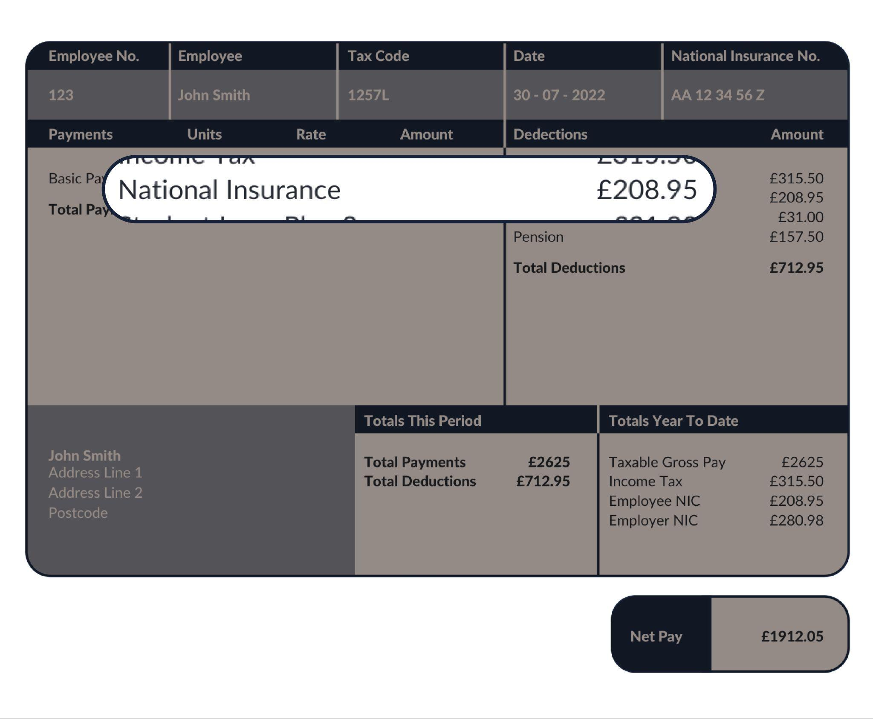
Starting with your taxes
Karim
National Insurance
Paid on earnings
Used for general public spending
The more you earn, the more you pay (to a point)
You need a minimum 35 years of paying this to qualify for a state pension
Used for general public spending
The more a person earns, the more they pay (to a point)
Karim

Slide 21
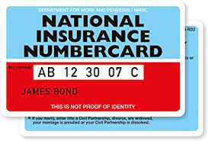
What is National Insurance (NI) all about?
A NI number is like a personal account number with the government and it NEVER changes
The number is needed for different applications e.g. when starting a job, if claiming benefits and taking a mortgage out. The list goes on!
Everyone pays National Insurance when they’re over 16 years old and earn or have self-employed profits over a certain amount, called a threshold.
Did you know?
Until 2011 cards were issued.
Now, a letter is sent in the post just ahead of a person’s 16th birthday!
Top tip! If you cannot memorise your National Insurance number make a note and keep it in a safe place,

Slide 22
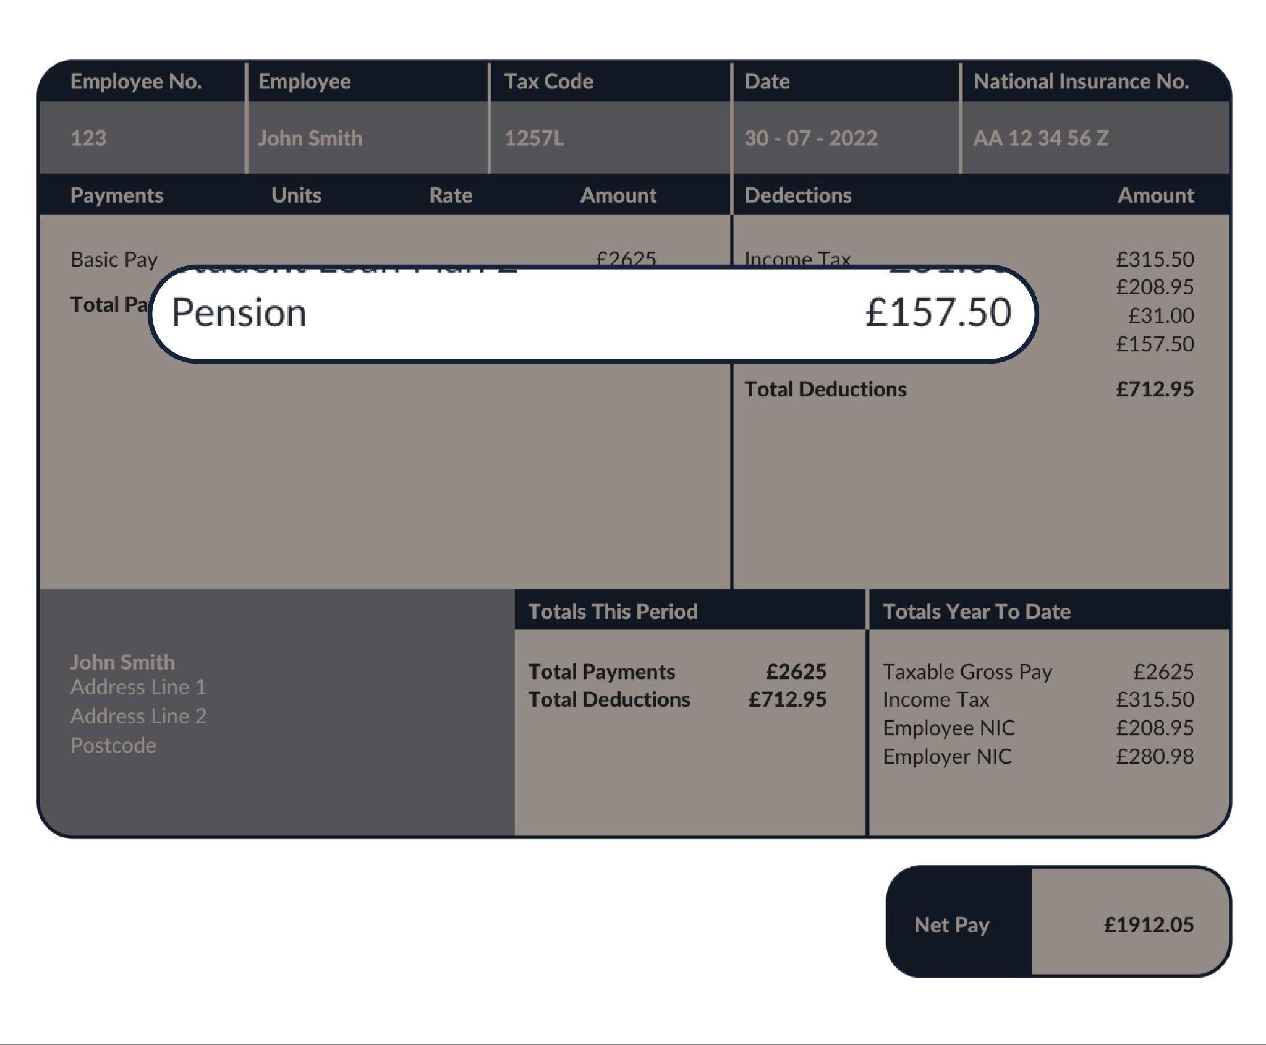
Other deductions
Pensions
Karim
Some people also pay into a pension, and their employer will contribute too
It goes towards a person’s income after they stop working in older age so it’s a way of saving money for later in life
It gets invested in the hope that it will grow
You can use it when you retire, from the age of 55 and moving to 57 from 2028
Karim

Slide 23
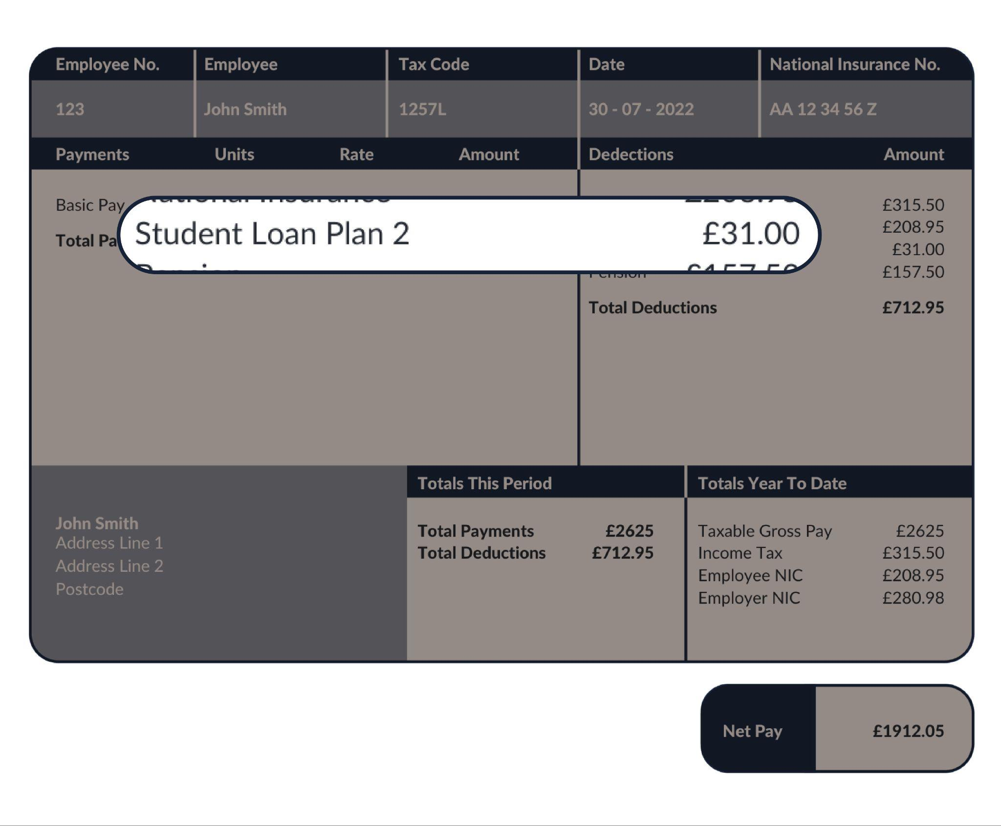
Other deductions
Karim
Student Loan
Money borrowed to pay for university education
It is paid back through salary deductions. The deduction is based on how much you earn, not how much you borrow
Karim
Notes:
Teacher explanation
Key point for students, a pensions and student loan can be considered as more of an personal investment than a deduction.
Whilst many people can be put off by the cost of higher education, the deduction is less than other deductions and only applicable once a person is earning over a certain amount.

Slide 24
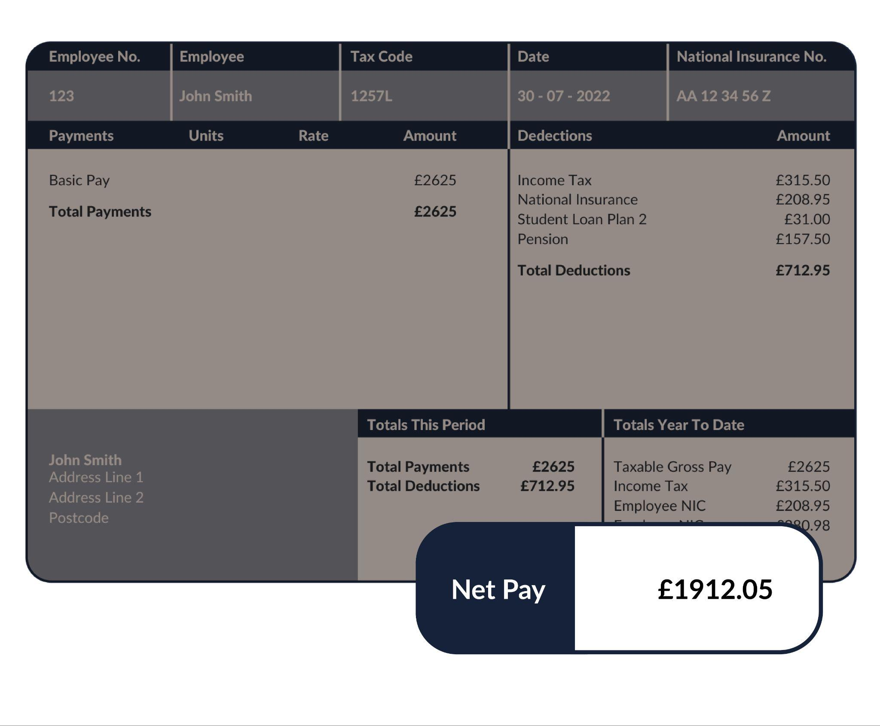
Net pay
Karim
Net Pay
What’s left after deductions have been made
Karim

Slide 25
Calculating net pay
After tax has been deducted, how much money will a person actually take home?
Monthly NET pay =
BASIC PAY
INCOME TAX
NATIONAL INSURANCE
PENSIONS
STUDENT LOANS
minus

Slide 26
Activity | Fill in the gaps using the word bank
When Darren gets a job as a lawyer and is told his annual salary, each month he works out his (1)………………….. by taking his total annual salary and dividing it by 12. There are then several (2)………………….., which are amounts of money taken away from gross pay. The biggest deduction is usually
(3) …………….……, which is a tax that goes up the more he earns. This is known as a (4)........................................ This is collected and spent on things like the NHS, (5)........................................
Because Darren has been to university and took out a (6)................, he will need to pay chunks of this out on a monthly basis; he also chose to get a (7)............, which means he has a way of saving money for later in life.
Finally he is left with his (8)………..…….. which is a very important number because it’s the amount that comes into his bank account. He will then use this number to help him budget!
Wordbank
progressive tax education and transport deductions monthly gross pay
net pay pension student loan income tax

Slide 27
ANSWERS | Fill in the gaps using the word bank
When Darren gets a job as a lawyer and is told his annual salary each month he works out his monthly gross pay by taking his total annual salary and dividing it by 12. There are then several deductions, which are amounts of money taken away from gross pay. The biggest deduction is usually income tax, which is a tax that goes up the more he earns. This is known as a progressive tax. This is collected and spent on things like the NHS, education and transportation.
Because Darren has been to university and took out a student loan he will need to pay chunks of this out on a monthly basis; he also chose to get a pension, which means he has a way of saving money for later in life.
Finally he is left with his net pay, which is a very important number because it’s the amount that comes into his bank account. He will then use this number to help him budget!
Wordbank
progressive tax education and transport deductions monthly gross pay
net pay pension student loan income tax

Slide 28
By the end of the session, I will be able to:
Describe the main salary deductions
Identify and explain key elements of a payslip
Calculate income tax for different job salaries

Slide 29
Calculating income tax
We’re going to take a deep dive into income tax, so that we understand how it works in reality!
Get ready to be income tax experts in just a bit.
Before handing over to you to calculate income tax for different jobs, we will practice using a worked example together.

Slide 30
Income tax bands
INCOME TAX (UK, not Scotland)
Tax rates and bands | Threshold (from April 2022)
Personal Allowance 0% | £12,570
Basic Rate 20% | £12,571 to £50,270
Higher Rate 40% | £50,271 to £125,140
Additional Rate 45% | Over £125,140
Governments will change these rates and bands over time, so always check for yourself!

Slide 31


How much annual income tax does a Man City female player pay?
Each football player earns on average £75,000 per year
How much does a player pay in income tax on £75,000?
We’re going to explore this looking at tax bands.
Governments will change these rates and bands over time, so always check for yourself!
Notes:
https://www.bbc.co.uk/news/entertainment-arts-62133808

Slide 32
For a £75,000 salary, how do the tax bands work?
No tax is paid on the first £12,570!
Personal Allowance
* People earning over £100,000 gradually lose their entitlement to their personal allowance. The Personal Allowance goes down by £1 for every £2 of income above the £100,000 limit. These rates and bands can change so always check for yourself.
Please note: tax bands are changing from April 2023 and will be reflected in FLIC materials.

Slide 33
For a £75,000 salary, how do the tax bands work?
No tax is paid on the first £12,570!
Personal Allowance
Basic Rate
* People earning over £100,000 gradually lose their entitlement to their personal allowance. The Personal Allowance goes down by £1 for every £2 of income above the £100,000 limit. These rates and bands can change so always check for yourself.
20% tax is paid on income between £12,571 and £50,270
Please note: tax bands are changing from April 2023 and will be reflected in FLIC materials.

Slide 34
How do the tax bands work?
No tax is paid on the first £12,500!
Finally, we see that her salary lies in the Higher Rate tax band.
So 40% tax is paid on the difference between £50,271 and £75,000
Personal Allowance
Basic Rate
Basic Rate
Higher Rate
20% tax is paid on income between £12,571 and £50,270
Please note: tax bands are changing from April 2023 and will be reflected in FLIC materials.

Slide 35
Own your income tax!
Worked example with annual salary of £75,000
Tax rates and bands | What’s taxable? | Tax to pay
Personal allowance at 0% £0 to £12,570 | £0 to £12,570 (for income less than £100,000) | 0 x £12,570 = £0

Slide 36
Own your income tax!
Worked example with annual salary of £75,000
Tax rates and bands | What’s taxable? | Tax to pay
Personal Allowance at 0% £0 to £12,570 | £0 to £12,570 (for income less than £100,000) | 0 x £12,570 = £0
Basic Rate at 20% £12,571 to £50,270 | £50,270 - £12,571 = £37,699 | 0.20 x £37,699 = £7,539.80

Slide 37
Own your income tax!
Worked example with annual salary of £75,000
Tax rates and bands | What’s taxable? | Tax to pay
Personal Allowance 0% £0 to £12,570 | £0 to £12,570 | 0 x £12,570 = £0
Basic Rate at 20% £12,571 to £50,270 | £50,270 - £12,571 = £37,699 | 0.20 x £37,699 = £7,539.80
Higher Rate at 40% £50,271 to £125,140 | £75,000 - 50,271 = £24,729 | 0.40 x £24,729 = £9,891.60
The salary falls in this tax band
* People earning between £100,000 and £125,000 gradually lose their entitlement to their personal allowance. By the time they reach £125,000, the personal allowance is gone and everything they earn up to £50,270 is taxed 20%

Slide 38
Own your income tax!
Worked example with annual salary of £75,000
Tax rates and bands | What’s taxable? | Tax to pay
Personal Allowance at 0% £0 to £12,570 | £0 to £12,570 (for income less than £100,000) | 0 x £12,570 = £0
Basic Rate at 20% £12,571 to £50,270 | £50,270 - £12,571 = £37,699 | 0.20 x £37,699 = £7,539.80
Higher Rate at 40% £50,271 to £125,140 | £75,000 - 50,271 = £24,729 | 0.40 x £24,729 = £9,891.60
Additional Rate at 45% Over £125,140 | No income tax paid at this rate | No income tax paid at this rate
Total income tax |  | £0 + £7,539.80 + £9,891.60 = £17,431.40

Slide 39
Own your income tax!
Quick quiz on tax bands
Which tax band(s) do these incomes fall in?
David earns £42,000 a year
Jorge earns £55,000 a year
The Managing Director of David’s bank, Andrea, earns £160,000 a year
Ken earns £35,000 a year
Zara earns £12,000 a year
Tax rates and bands | Threshold (from April 2022 to April 2023)
Personal Allowance 0% | £12,570
Basic Rate 20% | £12,571 to £50,270
Higher Rate 40% | £50,271 to £125,140
Additional Rate 45% | Over £125,140
ANSWERS | Which tax band(s) do these incomes fall in?
Basic rate tax band
Basic rate and some income in Higher rate tax band
Basic rate, Higher rate and some income in Additional rate tax band
Basic rate tax band
It’s within the Personal allowance so she pays no income tax
Notes:
Teacher guidance notes:
Ask student to draw the continuum line (bottom right image) to support their thinking. This activity should be used to highlight the misconception that when your salary falls in e.g. a Higher rate tax band, not ALL of your salary is taxed at the higher rate of 40%, but the amount that sits in the new band.
This quiz acts as a scaffold and support before the income tax calculations worksheet. For students that you see are less confident, encourage them to choose lower salary jobs when they begin the worksheet. Vice versa for more confident students.

Slide 40
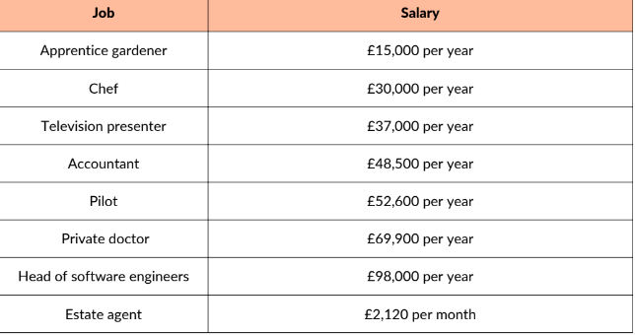
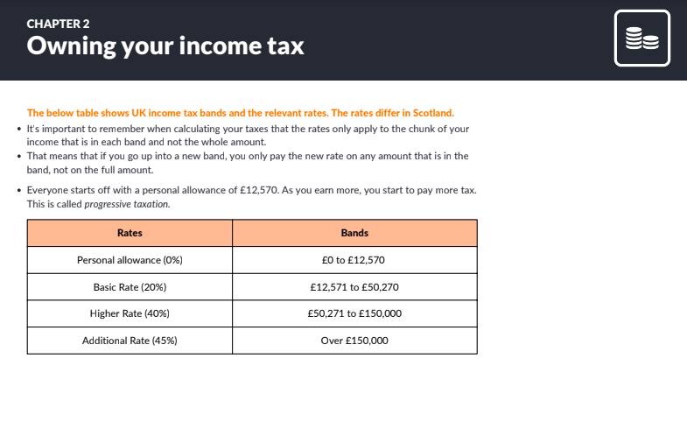
Calculating annual income tax
How much income tax does a person pay for different salaries?
Choose 1-2 jobs from the list given and calculate the income tax
Resource 4: Owning your income tax

Slide 41
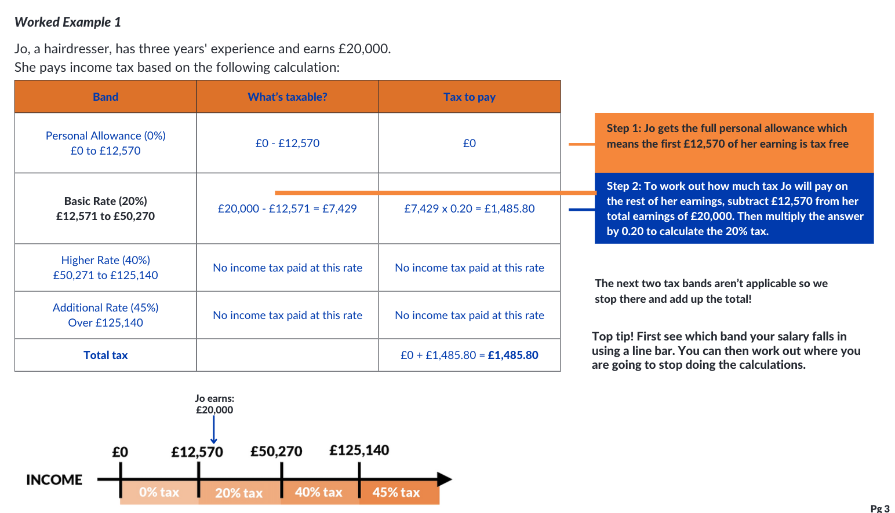
Worked example | Calculating monthly pay

Slide 42
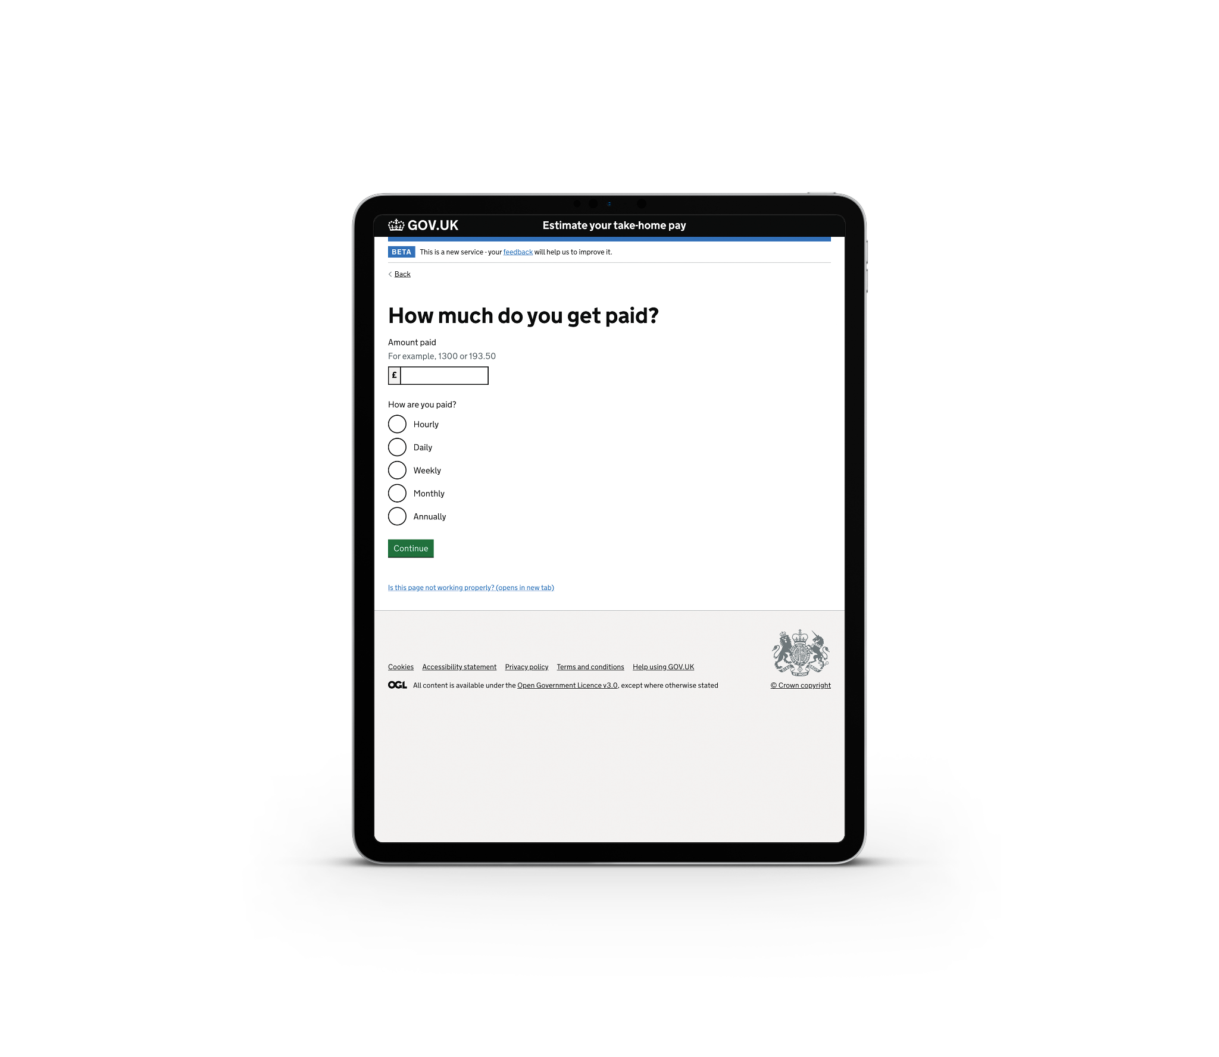
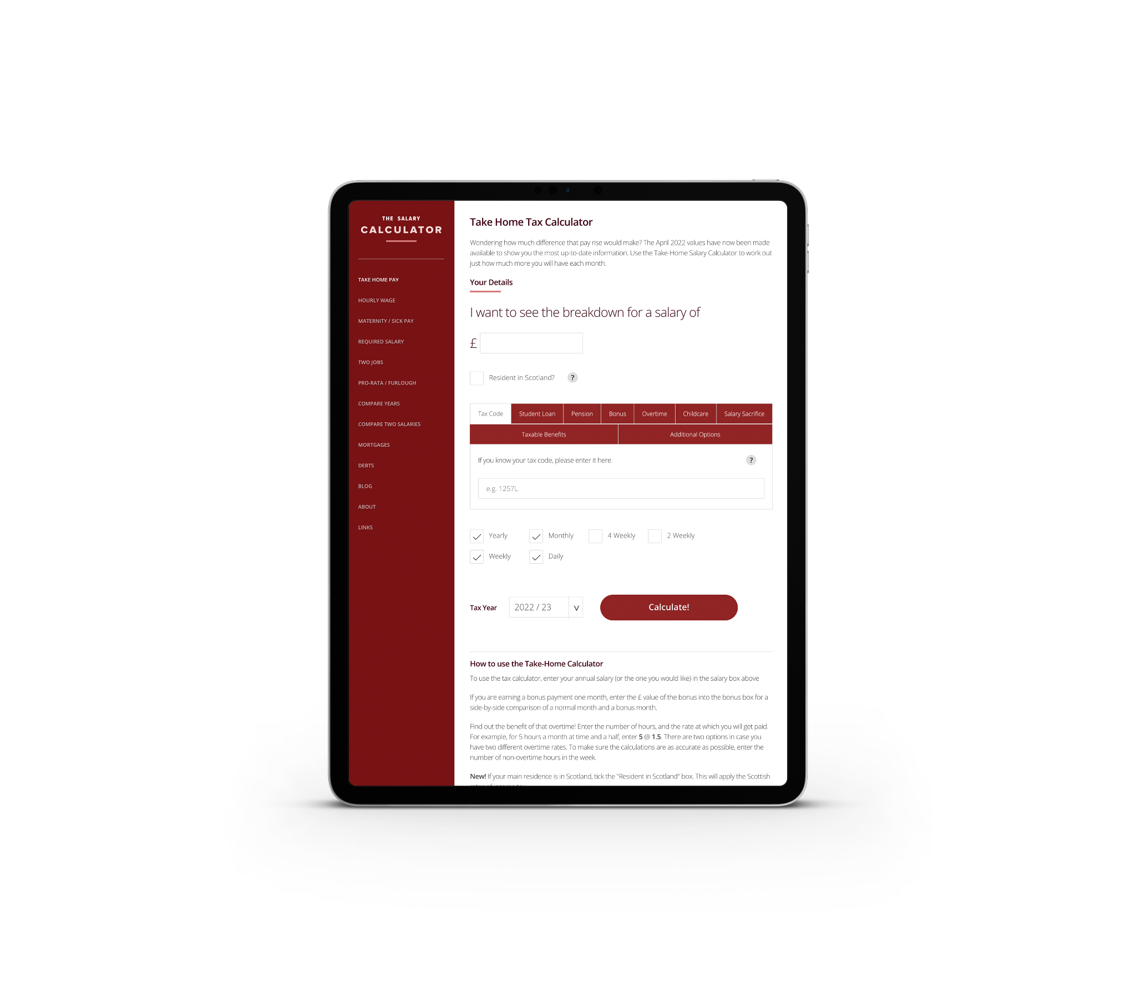

Where can I go for some online support working out my deductions?
Government website
The Salary Calculator
Listen to Tax Man

Slide 43
Own your income tax! Over to you!
INCOME TAX (UK, not Scotland)
Choose two jobs that you’re interested in from the worksheet and calculate the income tax.
Tax rates and bands | Threshold (from April 2022)
Personal Allowance 0% | £12,570
Basic Rate 20% | £12,571 to £50,270
Higher Rate 40% | £50,271 to £150,000
Additional Rate 45% | Over £150,000
Governments will change these rates and bands over time, so always check for yourself!

Slide 44
Calculating annual income tax
How much income tax does a person pay for different salaries?
Choose 1-2 jobs from the list given and calculate the income tax
Resource 4: Owning your income tax

Slide 45
Worked example | Calculating monthly pay

Slide 46
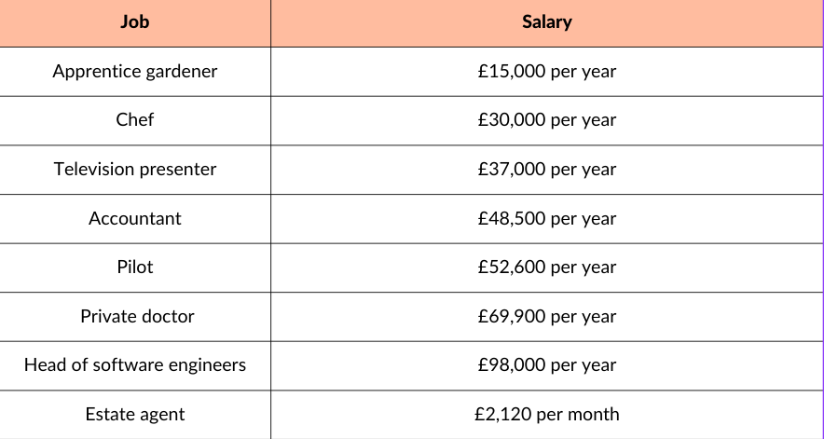
Discussion and answers
What have you noticed about the income tax you’ve calculated?
How does it change when the salary is just above or below the tax band?
Job | Annual income tax
Apprentice gardener | £485.80
Chef | £3,485.80
Television presenter | £4,885.80
Accountant | £7,185.80
Pilot | £8,471.40
Private doctor | £15,391.40
Head of software engineers | £26,631.40
Estate agent | £2,573.80 (£214.50 per month)
Allow £1 above or below answers for rounding differences.
Please note: tax bands are changing from April 2023 and will be reflected in FLIC materials.
Notes:
Teacher explanation
Key points to draw out from students
The apprentice gardener’s income tax is very small compared to the other jobs because most of the income is not taxed as it falls in the personal allowance category
Income tax rises with different salaries but is not directly proportional to the salary increase due to the progressive nature of UK taxation and the bands.
When the salary is just above a salary tax band, only a small amount is taxed in the higher salary band

Slide 47
Multiple choice Q1
Who is in charge of collecting tax for the whole country?
A | B | C
HMRC (His Majesty’s Revenue and Customs) | Local councils | The Chancellor of the Exchequer

Slide 48
Multiple choice Q1
Who is in charge of collecting tax for the whole country?
A | B | C
HMRC (His Majesty’s Revenue and Customs) | Local councils | The Chancellor of the Exchequer

Slide 49
Multiple choice Q2
2. In the UK income tax rates are progressive, meaning
A | B | C
A person pays the same proportion of tax no matter how much they earn | The more someone earns, the less income tax they pay | The more someone earns, the more they pay

Slide 50
Multiple choice Q2
2. In the UK income tax rates are progressive, meaning
A | B | C
A person pays the same proportion of tax no matter how much they earn | The more someone earns, the less income tax they pay | The more someone earns, the more they pay

Slide 51
Multiple choice Q3
3. If a person is self employed…
A | B | C
they are responsible for completing their own self-assessment tax return | HMRC will write to them to let them know how much tax to pay | they need an accountant to complete the self-assessment tax return form

Slide 52
Multiple choice Q3
3. If a person is self employed…
A | B | C
they are responsible for completing their own self assessment tax return | HMRC will write to them to let them know how much tax to pay | they need an accountant to complete the self-assessment tax return form

Slide 53
Multiple choice Q4
4. The biggest proportin of tax in the UK is spent on
A | B | C
Defence | Social protection (including pensions and welfare benefits) | Health

Slide 54
Multiple choice Q4
4. The biggest proportion of tax in the UK is spent on
A | B | C
Defence | Social protection (including pensions and welfare benefits) | Health

Slide 55
Multiple choice Q5
5. If a person is taxed wrongly (i.e. overpaid or underpaid)
A | B | C
HMRC will immediately pick it up and call the person | Their employer is responsible for correcting the mistake | They are responsible for calling HMRC and resolving the mistake

Slide 56
Multiple choice Q5
5. If a person is taxed wrongly (i.e. overpaid or underpaid)
A | B | C
HMRC will immediately pick it up and call the person | Their employer is responsible for correcting the mistake | They are responsible for calling HMRC and resolving the mistake

Slide 57

Optional video | Taxes and the world of work
Watch here: https://www.youtube.com/watch?v=P26wizs8I20
Notes:
The world of work video: https://www.youtube.com/watch?v=P26wizs8I20

Slide 58
Plenary
55
What are the 3 most important messages that you’ll take away from this lesson?

Slide 59
By the end of the session, I will be able to:
Describe the main salary deductions
Identify and explain key elements of a payslip
Calculate income tax for different job salaries

Slide 60
Any questions?
?

Slide 61



Services available for people who have concerns about their personal finances
Citizens Advice – Debt and Money – This resource contains links to advice on a number of topics, including financial difficulties, cost of living and communicating with creditors.
National Debtline – Debt and Money – a debt advice charity run by the Money Advice Trust, offering a free and confidential debt advice service.
Childline Helpline
0800 1111
At school, you can speak with an adult you trust.
This could be your form tutor, head of year or the school’s safeguarding officer.

Slide 62
Links to learn more!
Please visit the FLIC learning hub - https://ftflic.com/learning-hub/ for further resources

