Slide 1
How to plan for the world of work
This session is aimed at key stage four (recommended for Year 10)

Slide 2
Unit outline
Session 1 | Session 2 | Session 3 | Session 4 | Session 5 | Session 6
Careers in the City | Apprenticeships | Entrepreneurship | Understanding gig work and employment rights | Speaking up at work | Decision- making Creating a career plan

Slide 3
Having a respectful learning environment
We will listen to each other respectfully
We will avoid making judgements or assumptions about others
We will comment on what has been said, not the person who has said it
We won’t put anyone on the spot and we have the right to pass
We will not share personal stories or ask personal questions
If there is a question that you do not wish to ask aloud, you can write it on a Post-it Note which will be collected throughout the session and answered at the end

Slide 4
Session 5:
Speaking up at work

Slide 5
By the end of the session, I will be able to:
Identify different pay-related issues
Demonstrate the skills to stand up for rights at work
Explain sources of support

Slide 6
Starter
“I’m experiencing pay problems at work. What should I do?”
Write a list of the pay issues might people experience
at work?
Stretch: What advice would you give to the person?

Slide 7
Starter
Did you consider…
Not being paid on time
Incorrect pay
Wrong tax code
Would like a pay rise
Cost of living has increased
Notes:
Teacher explanation
Use the last point to introduce the concept of rising inflation meaning people either buy less though they are spending the same as they were in previous months.

Slide 8
Nominal vs Real Wages
Inflation occurs when the price of goods and services rise over time (usually a year). Rather than looking at individual goods, it tracks changes in the price of a large basket of goods, and gives an average change that is expressed as a percentage.
In the UK, January 2023, the inflation was at 10.1%.
If prices rise, but a person’s wage remains the same, they’ll be able to buy fewer goods and services. In 2023, wages increased by 6%. This is what we call a nominal wage increase.
Real wages take the effect of inflation into account.
You can work out the change in real wages by subtracting the rate of inflation from the change in nominal wages
=
Change in real wage (%)
Change in nominal wage (%)
-
Rate of inflation (%)
What was the change in real wage in 2023?
6% - 10.1% = -4.1%
Notes:
Teacher delivery
Invite students to share their answer to the ‘change in real wage’. Use prompt questions to further class discussion.
Prompt Question
What might the negative sign tell you?
Thinking about the definition of ‘real wages’, how might a person’s finances be affected if their real wages are falling?
Reiterate that because wages are rising slower than the price of goods and services, fewer items can be purchased, and this will impact standard of living.

Slide 9
Asking for a pay rise
Inflation isn’t the only reason people ask for a pay rise.
It is common for workers to ask for pay rises based on other factors within their job.
Can you think of any other reasons why someone may ask for a pay rise?
New responsibilities
Significant achievements
Currently underpaid
Developed new skills
Acts as a mentor to other employees
Job offers from elsewhere
Hours of employment extended

Slide 10
Asking for a pay rise
10
Using full sentences, you have two minutes to write a few sentences explaining why someone might have an issue with their pay

Slide 11
By the end of the session, I will be able to:
Identify different pay-related issues
Demonstrate the skills to stand up for rights at work
Explain sources of support

Slide 12
Making a case for a pay rise
In pairs, you’re going to pick the strongest arguments for a pay rise pitch using Jonathan’s scenario.
Make your case to each other (5 mins to prep, 2 mins each to share). How convincing can you be?
Jonathan
Marketing manager at top fashion brand

Slide 13
Making your case
Meet Jonathan
Jonathan works in the marketing department at a large fashion brand. At the start of the year he was involved in a big project that led to a £200,000 increase in the company’s profit. But he hasn’t had a pay rise since he started working there three years ago. Furthermore, two members of the team left and were not replaced, so Jonathan has picked up their work too, working over his contracted hours at least a couple of days a week.
At the same time, over the past year, inflation has risen to 10% meaning a lot of his costs and the things he buys have become much more expensive. He’s noticed the cost of petrol, his weekly food shop and heating bill rise a lot!
What should Jonathan say to his boss?
Can you identify the key points for his pay rise pitch?
Notes:
Prompt Questions
Consider the reasons why someone might ask for a pay rise that we saw two slides ago. Can you identify any of these factors here?

Slide 14
Making your case - Points to consider
Meet Jonathan
Jonathan works in the marketing department at a large fashion brand. At the start of the year he was involved in a big project that led to a £200,000 increase in the company’s profit. But he hasn’t had a pay rise since he started working there three years ago. Furthermore, two members of the team left and were not replaced, so Jonathan has picked up their work too, working over his contracted hours at least a couple of days a week.
At the same time, over the past year, inflation has risen to 10% meaning a lot of his costs and the things he buys have become much more expensive. He’s noticed the cost of petrol, his weekly food shop and heating bill rise a lot!
What should Jonathan say to his boss?
After five minutes of writing, pitch to one another…
Notes:
Teacher delivery
Whole class assessment for learning can be used by asking students to show with hands how many factors they identified (out of 5).

Slide 15
Top tips when asking for a pay rise
Employees should…
Be specific when it comes to the value of their work, both in terms of what they have achieved and how they have achieved results
Demonstrate the value they will bring to the employer in the future
Discuss their soft skills and how they add value internally to the company e.g. organising a volunteers’ day, or supported colleagues through problems?
Use facts where possible e.g. “Outcomes of the project led to a 10% increase in sales last year”
Prepare key points before booking a meeting with the manager
Use clear and concise language

Slide 16
By the end of the session, I will be able to:
Identify different pay-related issues
Demonstrate the skills to stand up for rights at work
Explain sources of support

Slide 17
Request declined
If Jonathan feels he is being treated unfairly, what individuals or organisations are available to help with work-related issues?

Slide 18
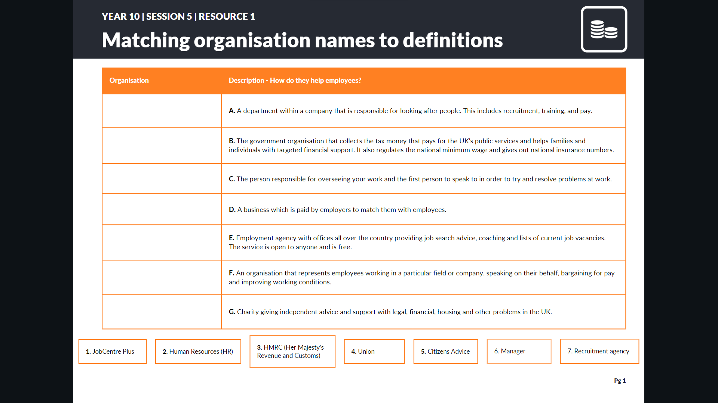
Resolving work issues
People or organisations you should get to know.
Match the definition to the organisation!
Resource 1 - Resolving work issues

Slide 19
Resolving Pay Problems
ANSWERS | People or organisations you should get to know

Slide 20
Resolving Pay Problems
Who should you speak to? Match the 8 scenarios to the 8 blue answer cards
Notes:
Teacher delivery
Give students time to work through 8 scenarios. Option to use as card sort.
If time is short, use slight amination and targeted questioning or mini whiteboards to assess student learning.

Slide 21
Resolving Pay Problems
ANSWERS | Who should you speak to?

Slide 22
Finances and Well-being
For many families managing finances and budgeting from net pay has been difficult because of inflation. Inflation is when prices rise, and inflation has been rising a lot, reducing purchasing power (how far money can go in terms of spending).
There are things that people can do to adjust their budgets including reconsidering what things are needs and wants.
Remember that inflation changes over time and this period will not last forever.
There are many sources of advisory services and help for families who are experiencing financial difficulties.
Notes:
Teacher delivery
Emphasize to students that there are many options to seek support and people should use these services.

Slide 23
Optional
Use the scenarios on the next slide to have another opportunity to demonstrate how people can stand up for their rights at work. Select relevant information from what you have learnt today.

Slide 24
Standing Up For Yourself
What will you say?
In pairs, take turns to read out one of the scenarios.
If person A reads the scenario, person B must then develop an appropriate response, considering the things we have learnt today. Person A will then give feedback on the response, before you switch roles.
“I’m really sorry that we haven’t paid you for last month yet. We’ve been going through some financial difficulties. Just give us some time to get back on our feet”
“Thanks for taking on that project for Jenny over the last two weeks. You see, it’d really help us out if you could also finish off this bit of analysis for me. I just don’t have the time I’m afraid”
“Hi, I know you’ve booked the time off, and it’s been a while since you’ve taken annual leave, but we could really do with a set of spare hands today. Can you come in?”
“I know you’ve worked incredibly hard since you joined us, but John has been here for years so there’s no way we could promote you ahead of him.”
“Being tired is all part of it. All of the junior workers go through it. Working 13-hour days is just a rite of passage.”

Slide 25
End of optional activity

Slide 26
Key takeaways
Prepare key points
Speak assertively but not aggressively
Use evidence and examples to explain
Know your value
Recognise that sometimes it's important to be flexible, but personal wellbeing is also important and a work-life balance and breaks are necessary to do your job well too.

Slide 27
3-2-1
Write down…
3 things you’ve learnt
2 skills you’ve practised
1 question you have about resolving issues at work

Slide 28
By the end of the session, I will be able to:
Identify different pay-related issues
Demonstrate the skills to stand up for rights at work
Explain sources of support

Slide 29
Any questions?
?

Slide 30
Services available for people who have concerns about their rights at work
Money Helper - Work
Gov UK - Workplace rights
Citizens Advice - Work
At school, you can speak with an adult you trust.
This could be your form tutor, head of year or the school’s safeguarding officer

Slide 31
Links to learn more!
Articles to extend learning
How does UK tax work? (Youtube ‘Joe Georgekutty’, Sept 2020)
What are the tax implications of earning over £100,000? (TaxScouts, July 2022)
Difference between sole trade and limited company (Youtube ‘Pennies to Pounds’, Nov 2020)
A guide to the living wage (Living Wage Foundation)
Benefits checker/calculator and grants finding website which also has useful info about benefits. (Turn to Us, UK National Charity)
BBC Sounds - Should we be more open about salaries?
Please visit the FLIC learning hub - https://ftflic.com/learning-hub/ for further resources

